Slide 1
2014 – A Year of Critical Issues for International Criminal Justice
Crime prevention through criminal law and security studies,
Dubrovnik, IUC
March 2014

Slide 2
Inter-University Centre Dubrovnik
Founded in 1972
Independent academic institution
Aim of promoting academic and university cooperation
More than 172 universities have been involved in IUC activities, courses, seminars, conferences

Slide 3
IUC building
Constructed in early 20th century
Originally it was a school
Rich history
Building was severely damaged during bombardment in 1991

Slide 4
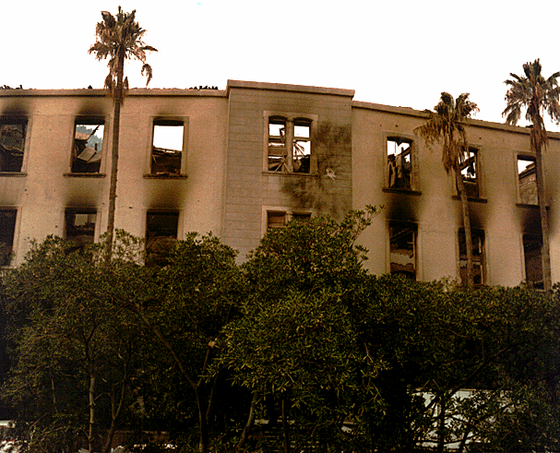

Slide 5
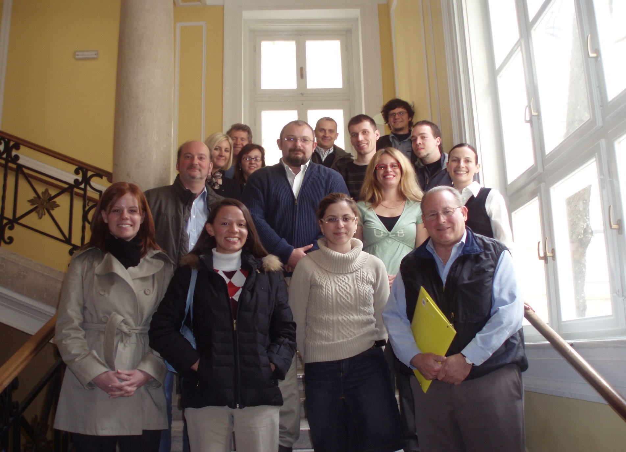

Slide 6
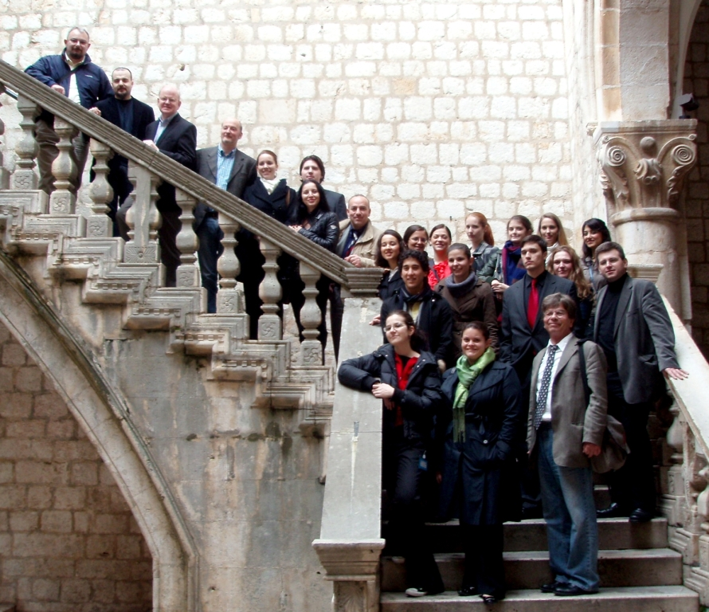

Slide 7
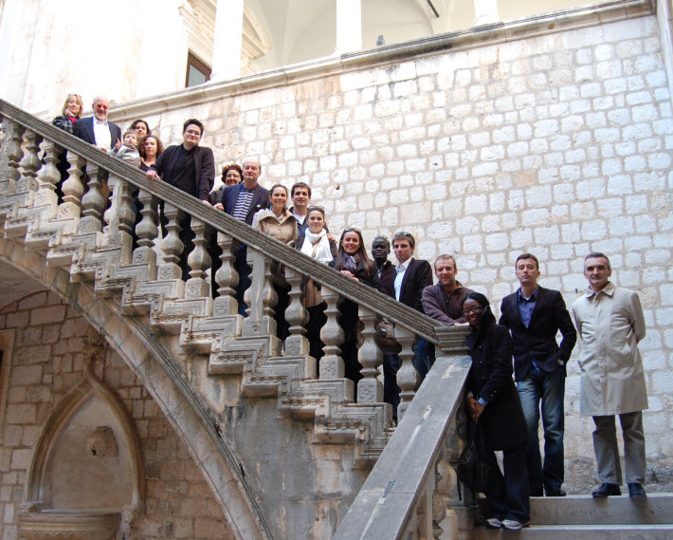

Slide 8
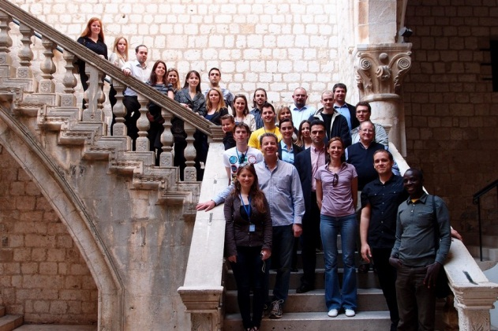

Slide 9
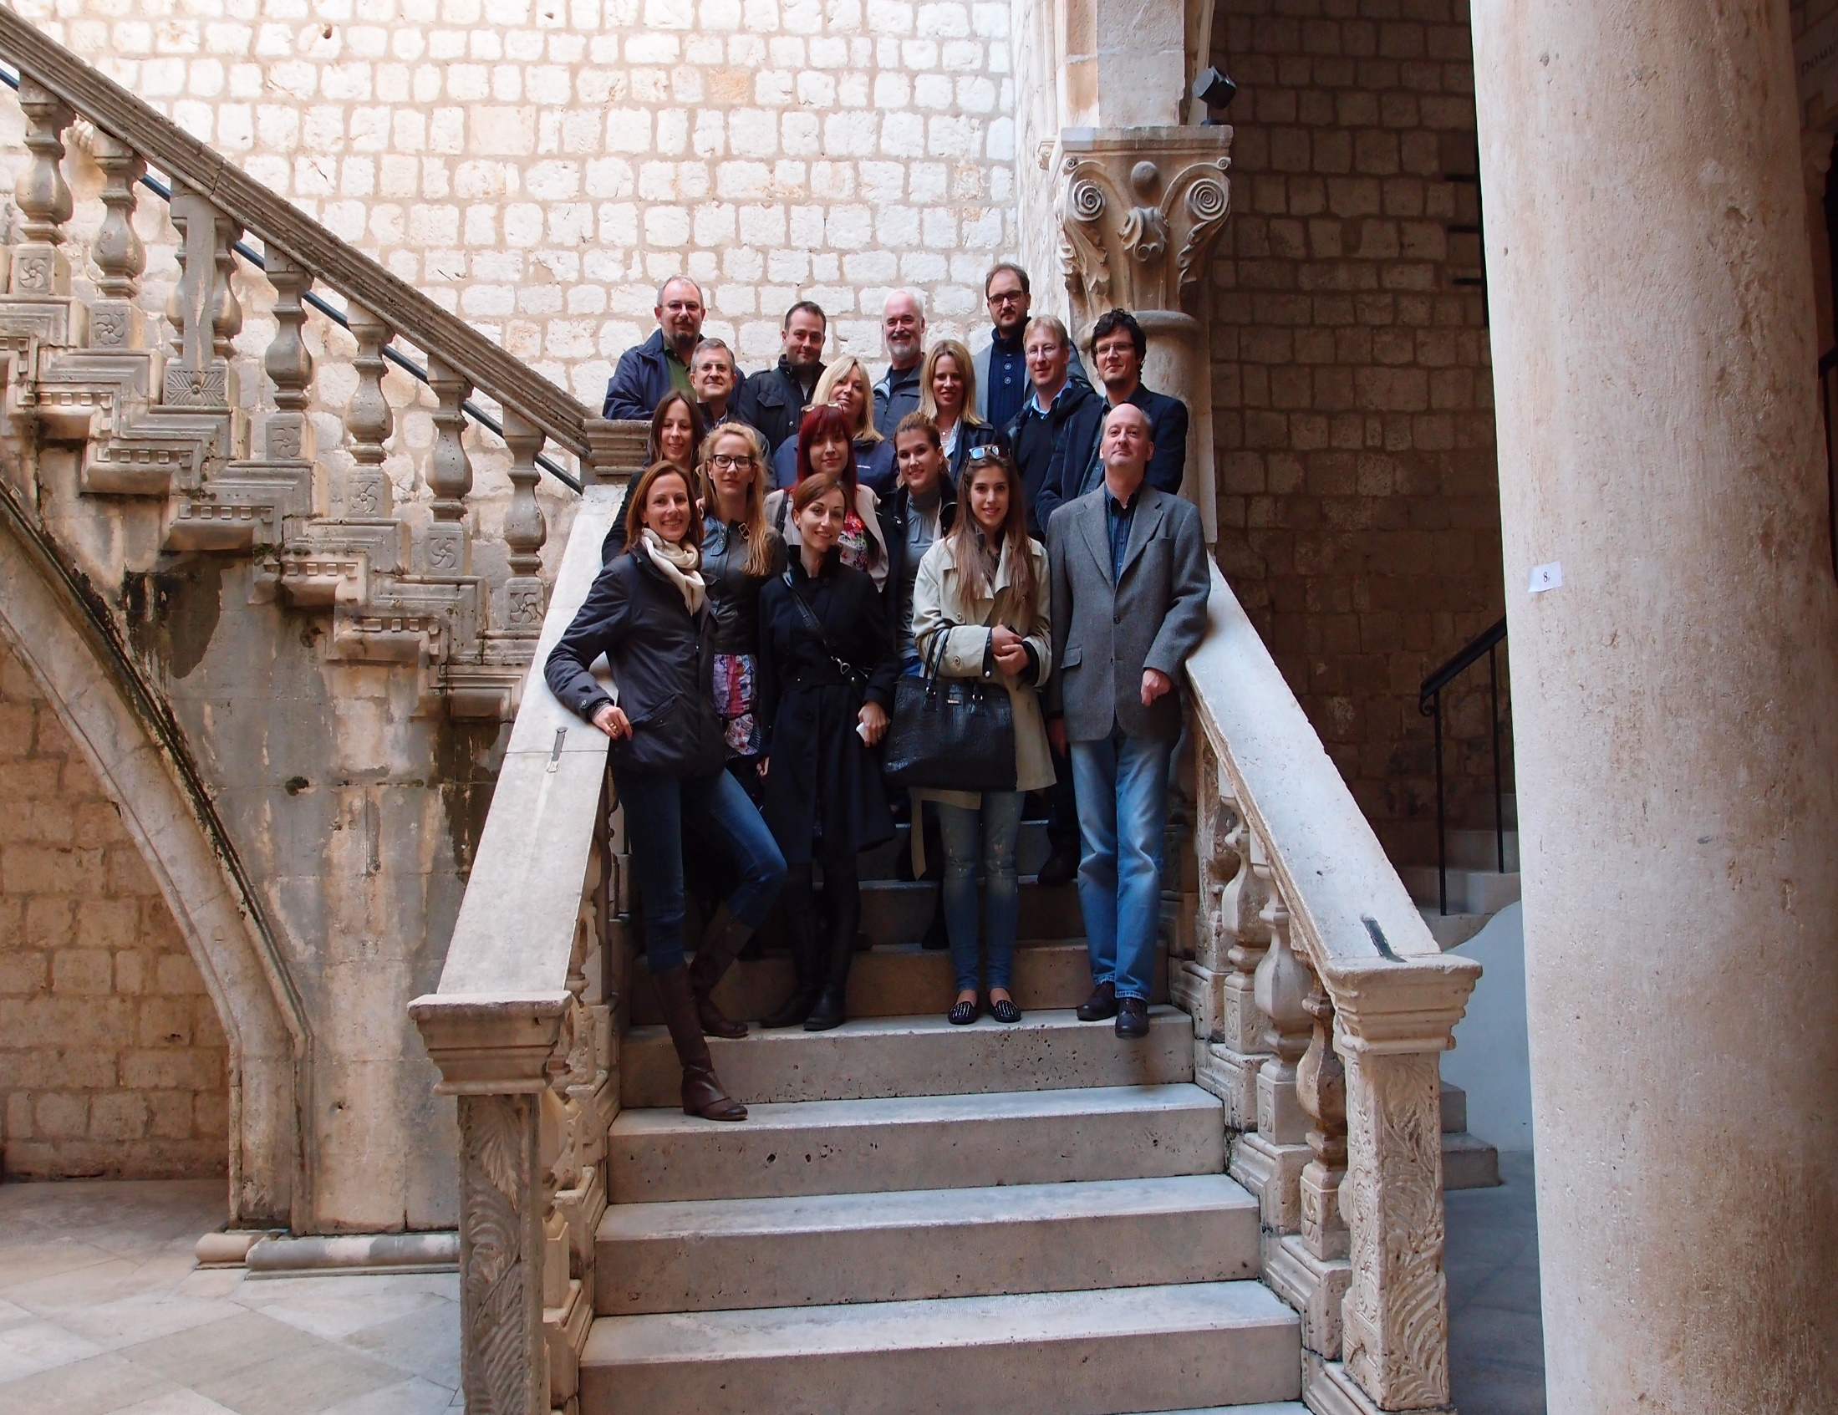

Slide 10
2014 - Three main focuses
Security and cyberspace
Trafficking in human beings
Death penalty

Slide 11
Security and cyberspace
Physical world vs. virtual (online) world
Privacy issues
Cyber victimization
Applicability of traditional criminal law to cybercrime
The role of regulatory agencies
http://www.youtube.com/watch?v=-E65SsT2PRc

Slide 12
Trafficking in human beings
Modern age slavery
Not just a crime but a human rights violation (Rantsev v. Cyprus and Russia, ECHR)
Changing nature of the phenomenon
Palermo protocol and COE Convention
COE monitoring mechanisms – GRETA and Committee of the Parties
http://www.youtube.com/watch?v=zHJepW-LL7U

Slide 13
Death penalty
Right to life
Retribution and prevention (through deterrence)
Cruel and unusual?
Effects? Costs?
Evolving standards of decency
International cooperation in criminal matters
http://www.youtube.com/watch?v=t59f53irwTA -

Slide 14
Thank you!

