Slide 1
Emptio venditio – Contract of Sale II. Pretium (price)
ROMAN PRIVATE LAW, 2016/2017
LECTURE DOC. KARLOVIĆ

Slide 2
Pretium (price)
1. Nummerata pecunia – in money
2. Pretium certum – certain or at least ascertainable
3. Pretium verum – seriously meant
4. Pretium iustum – just or fair price

Slide 3
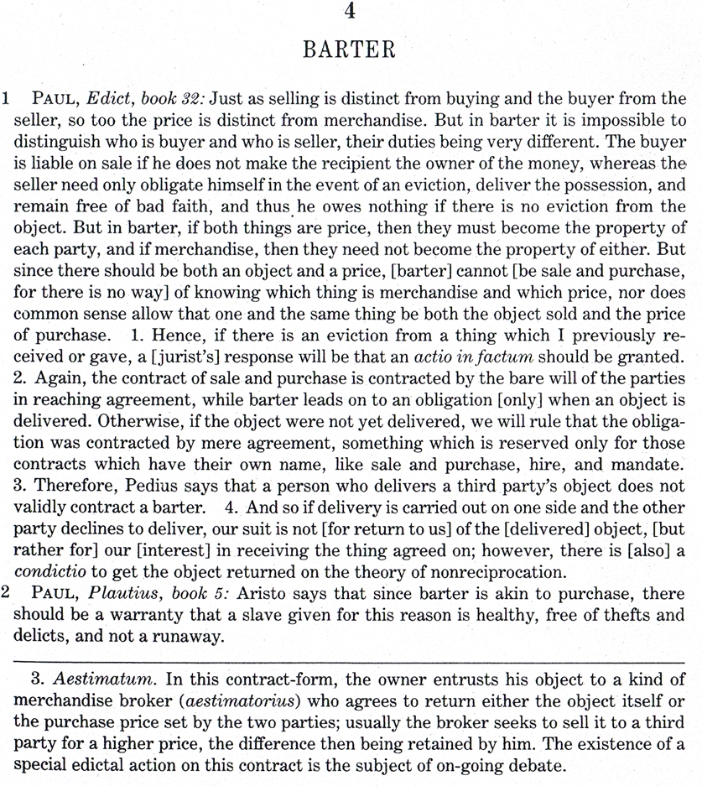
1. Nummerata pecunia
Price had to consist in money – Proculians
Possible partial payment in goods or services

Slide 4
D. 19.1.6 Pomponius libro nono ad Sabinum
1. Si vendidi tibi insulam certa pecunia et ut aliam insulam meam reficeres, agam ex vendito, ut reficias: si autem hoc solum, ut reficeres eam convenisset, non intelllegitur emptio et venditio facta, ut et neratius scripsit.
2. Sed si aream tibi vendidi certo pretio et tradidi, ita ut insula aedificata partem dimidiam mihi retradas, verum est et ut aedifices agere me posse ex vendito et ut aedificatam mihi retradas: quamdiu enim aliquid ex re vendita apud te superesset, ex vendito me habere actionem constat.
1. If I sold you a building in exchange for a fixed sum of money plus your promise to repair another building of mine, I may sue you on the purchase to force this repair; but if our agreement was only that you repair it, a contract of sale is not construed as having been made. Neratius wrote this as well.
2. But if I sold and delivered a lot to you in exchange for a fixed sum of money plus your promise to deliver half of it back to me after a building is contructed on it, the correct position is that I can sue on the sale to force both construction and the redelivery to me after construction. It is generally held that I have a suit on the sale as long as some portion of the object of sale has remained with you.

Slide 5
2. Certainty of price
It does not have to be ascertained in figures, only the criteria have to agreed on which will give the figure without new negotiations
Invalid:
D.18.1.35 Gaius libro decimo ad edictum provinciale
1. Illud constat imperfectum esse negotium, cum emere volenti sic venditor dicit: "Quanti velis, quanti aequum putaveris, quanti aestimaveris, habebis emptum".
It is settled that no contract is concluded when the vendor says to the purchaser: „You shall buy for what you choose to give, or what you think fair or at your own estimate of its value.”

Slide 6
D. 18.1.7.1-2 Ulpianus libro 28 ad Sabinum
1. Huiusmodi emptio "quanti tu eum emisti", "quantum pretii in arca habeo", valet: nec enim incertum est pretium tam evidenti venditione: magis enim ignoratur, quanti emptus sit, quam in rei veritate incertum est.
2. Si quis ita emerit: "est mihi fundus emptus centum et quanto pluris eum vendidero", valet venditio et statim impletur: habet enim certum pretium centum, augebitur autem pretium, si pluris emptor fundum vendiderit
Translation – D. 18,1 - page 2

Slide 7
Effects
D.18.1.35 Gaius libro decimo ad edictum provinciale
6. Ergo et si grex venierit, si quidem universaliter uno pretio, perfecta videtur, postquam de pretio convenerit: si vero in singula corpora certo pretio, eadem erunt, quae proxime tractavimus.
Accordingly, when a whole flock is sold at a single price, the sale is perfect upon the agreement on the price; but if it be sold at so much per beas, what we have just set out will apply.*
D. 18.1.35.6: …if a price per thing is fixed. Sabinus and Cassius hold the view that the sale becomes perfect when the counting, measuring, or weighing has been done. …

Slide 8
3. Seriously meant
D. 18.1.36 Ulpianus libro 43 ad edictum
Cum in venditione quis pretium rei ponit donationis causa non exacturus, non videtur vendere.
D. 18.1.37 Ulpianus libro tertio disputationum
Si quis fundum iure hereditario sibi delatum ita vendidisset: "erit tibi emptus tanti, quanti a testatore emptus est", mox inveniatur non emptus, sed donatus testatori, videtur quasi sine pretio facta venditio, ideoque similis erit sub condicione factae venditioni, quae nulla est, si condicio defecerit.
Translation – D. 18,1 - page 7

Slide 9
D. 18.1.38 Ulpianus libro septimo disputationum
Si quis donationis causa minoris vendat, venditio valet: totiens enim dicimus in totum venditionem non valere, quotiens universa venditio donationis causa facta est: quotiens vero viliore pretio res donationis causa distrahitur, dubium non est venditionem valere. Hoc inter ceteros: inter virum vero et uxorem donationis causa venditio facta pretio viliore nullius momenti est.
Translation – D. 18,1 - page 7

Slide 10
4. Just price
In classical law no rules on just price
Parties are free to decide the amount of price as they wish and each party is authorized to make the most out of it
D. 19.2.22 Paulus libro 34 ad edictum
3. Quemadmodum in emendo et vendendo naturaliter concessum est quod pluris sit minoris emere, quod minoris sit pluris vendere et ita invicem se circumscribere, ita in locationibus quoque et conductionibus iuris est:
As it is naturally conceded in buying and selling to buy for less what is worth more, or to sell for more what is worth less, and in that manner to mutually „take advantage” of the other party, it is the same the law in letting (leasing) and hiring:

Slide 11
Cicero De officiis 3,12,49-50
49. Let it be set down as an established principle, then, that what is morally wrong can never be expedient — not even when one secures by means of it that which one thinks expedient; for the mere act of thinking a course expedient, when it is morally wrong, is demoralizing. 50. But, as I said above, cases often arise in which expediency may seem to clash with moral rectitude; and so we should examine carefully and see whether their conflict is inevitable or whether they may be reconciled. The following are problems of this sort: suppose, for example, a time of dearth and famine at Rhodes, with provisions at fabulous prices; and suppose that an honest man has imported a large cargo of grain from Alexandria and that to his certain knowledge also several other importers have set sail from Alexandria, and that on the voyage he has sighted their vessels laden with grain and bound for Rhodes; is he to report the fact to the Rhodians or is he to keep his own counsel and sell his own stock at the highest market price? I am assuming the case of a virtuous, upright man, and I am raising the question how a man would think and reason who would not conceal the facts from the Rhodians if he thought that it was immoral to do so, but who might be in doubt whether such silence would really be immoral.

Slide 12
Cicero De officiis 3,14,58-60
58. If, then, they are to be blamed who suppress the truth, what are we to think of those who actually state what is false? Gaius Canius, a Roman knight, a man of considerable wit and literary culture, once went to Syracuse for a vacation, as he himself used to say, and not for business. He gave out that he had a mind to purchase a little country seat, where he could invite his friends and enjoy himself, uninterrupted by troublesome visitors. When this fact was spread abroad, one Pythius, a banker of Syracuse, informed him that he had such an estate; that it was not for sale, however, but Canius might make himself at home there, if he pleased; and at the same time he invited him to the estate to dinner next day. Canius accepted. Then Pythius, who, as might be expected of a moneylender, could command favours of all classes, called the fishermen together and asked them to do their fishing the next day out in front of his villa, and told them what he wished them to do. Canius came to dinner at the appointed hour; Pythius had a sumptuous banquet prepared; there was a whole p329fleet of boats before their eyes; each fisherman brought in in turn the catch that he had made; and the fishes were deposited at the feet of Pythius.
59. "Pray, Pythius," said Canius thereupon, "what does this mean? — all these fish? — all these boats?""No wonder," answered Pythius; "this is where all the fish in Syracuse are; here is where the fresh water comes from; the fishermen cannot get along without this estate.„ Inflamed with desire for it, Canius insisted upon Pythius's selling it to him. At first he demurred. To make a long story short, Canius gained his point. The man was rich, and, in his desire to own the country seat, he paid for it all that Pythius asked; and he bought the entire equipment, too. Pythius entered the amount upon his ledger and completed the transfer.
The next day Canius invited his friends; he came early himself. Not so much as a thole-pin was in sight. He asked his next-door neighbour whether it was a fishermen's holiday, for not a sign of them did he see. "Not so far as I know," said he; "but none are in the habit of fishing here. And so I could not make out what was the matter yesterday."
60. Canius was furious; but what could he do? For not yet had my colleague and friend, Gaius Aquilius, introduced the established form to apply to criminal fraud. When asked what he meant by "criminal fraud," as specified in these forms, he could reply: "Pretending one thing and practising another" — a very felicitous definition, as one might expect from an expert in making them. Pythius, therefore, and all others who do one thing while they pretend another are faithless, dishonest, and unprincipled p331scoundrels. No act of theirs can be expedient, when what they do is tainted with so many vices.

Slide 13
Justinian s change
C. 4.44.2 Imperatores Diocletianus, Maximianus
Rem maioris pretii si tu vel pater tuus minoris pretii, distraxit, humanum est, ut vel pretium te restituente emptoribus fundum venditum recipias auctoritate intercedente iudicis, vel, si emptor elegerit, quod deest iusto pretio recipies. Minus autem pretium esse videtur, si nec dimidia pars veri pretii soluta sit.
DIOCL. ET MAXIM. AA. AURELIO LUPO. *<A 285 PP. V K. NOV. DIOCLETIANO A. II ET ARISTOBULO CONSS.>
If you or your father sold property for less than its value, it is just that you should receive it back, through the authority of the judge upon restoring the price, or that the purchaser, at his election, should pay you what is lacking of the just price (and keep the property). A price is considered too little if one half of the true value is not paid.

Slide 14
C. 4.44.8 Imperatores Diocletianus, Maximianus
Si voluntate tua fundum tuum filius tuus venumdedit, dolus ex calliditate atque insidiis emptoris argui debet vel metus mortis vel cruciatus corporis imminens detegi, ne habeatur rata venditio. Hoc enim solum, quod paulo minori pretio fundum venumdatum significas, ad rescindendam emptionem invalidum est. Quod videlicet si contractus emptionis atque venditionis cogitasses substantiam et quod emptor viliori comparandi, venditor cariori distrahendi votum gerentes ad hunc contractum accedant vixque post multas contentiones, paulatim venditore de eo quod petierat detrahente, emptore autem huic quod obtulerat addente, ad certum consentiant pretium, profecto perspiceres neque bonam fidem, quae emptionis atque v enditionis conventionem tuetur, pati neque ullam rationem concedere rescindi propter hoc consensu finitum contractum vel statim vel post pretii quantitatis disceptationem: nisi minus dimidia iusti pretii, quod fuerat tempore venditionis, datum est, electione iam emptori praestita servanda. * DIOCL. ET MAXIM. AA. ET CC. AURELIAE EUODIAE. *<A 293 D. K. DEC. AA. CONSS.>
If your son sold your land with your consent, fraud of the purchaser through cunning and trickery should be shown, or fear of death or imminent bodily harm, in order to avoid the sale. The fact that you state that the land was sold for a little less than its value, is not alone sufficient to invalidate the sale. For if you consider the nature of purchase and sale, that when the parties are intending to enter into such contract, the purchaser wants to purchase for less, the seller wants to sell for more, and that it is with difficulty and after many contentions, the seller gradually receding from what he asked, the purchaser adding to what he offered, that they finally consent to a definite price, you surely must see that neither good faith, which protects the contract of purchase and sale, nor any other reason, permits that the contract, completed by consent, either immediately or after discussion of the price, should be rescinded on that account, unless less than half of the value of the property at the time of the sale was given, and in such case the purchaser has the right of election already extended to him (to pay the remainder of the just price.) Given December 1 (293).

