Slide 1
Gozotuk and Brugge case

Slide 2
Legal instruments
Schengen Agreement growth of cross border crimes ne bis in idem
Convention implementing the Schengen Agreement of 14 June 1985 between the Governments of the States of the Benelux Economic Union, the Federal Republic of Germany and the French Republic on the gradual abolition of checks at their common borders (CISA) contains the following provision:
"A person whose trial has been
finally disposed of in one Contracting party
may not be prosecuted in another contracting party
for the same acts provided that,
a penalty has been disposed, it has been enforced, is actually in the process of being enforced or can no longer be enforced under the laws of the Contracting Party".

Slide 3
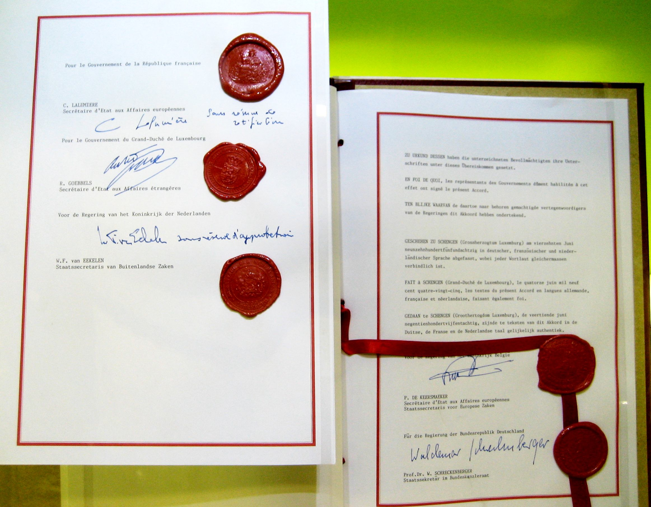
Jurisdiction
Schengen acquis (which consists of Schengen Agreement and Convention on Implementation Schengen Agreement - CISA) was integrated into the framework of the European Union by the Protocol annexed to the Treaty on European Union and to the Treaty establishing the European Community by the Treaty of Amsterdam.

Slide 4
Facts (Mr Gözütok):
Mr Gözütok is a Turkish national who has lived for several years in the Netherlands.
12 January and 11 February 1996 the Netherlands police found and seized several types of drugs and narcotic cigarettes.
In accordance with national code storage and selling of drugs are criminal punishable. At the same time, the Public Prosecutor's Office has a right to discontinue prosecution if a criminal accepts his offer of paying a certain amount of money. That possibility was used in the case.
The German authorities' attention was drawn to Mr Gözütok by a German bank which, on 31 January 1996, alerted them to the fact that large sums of money were passing through Mr Gözütok's account.
On 13 January 1997, the Amtsgericht Aachen (District Court, Aachen) (Germany) convicted Mr Gözütok and sentenced him to a period of one year and five months' imprisonment, suspended on probation.

Slide 5
Facts (Mr Brügge)
Mr Brügge, a German national residing in Germany has been charged by Belgian prosecuting authorities with having intentionally assaulted and wounded Mrs Leliaert, with the result that she became ill or unable to work.
German Public Prosecutor's Office has made Mr Brugge an offer, by way of a settlement, to discontinue the case after payment of a certain sum. And criminal agreed and paid a necessary sum of money.
Belgian Court asked whether the Belgian Public Prosecutor's Office permitted to require a German national to appear before a Belgian criminal court and be convicted on the same facts.

Slide 6
Question:
whether the ne bis in idem principle also applies to procedures whereby further prosecution is barred?

Slide 7
Alternative way of ending criminal procedure:
Offer of Public Prosecutor to discontinue a process in exchange of certain sum of money paid by criminal to a state
Criminal penalty

Slide 8
The Court`s answer
CISA | Interpretation
1) finally disposed of in one Contracting party | Classical one: the domestic laws and procedure of a signatory state do not provide for an appeal in specified circumstances; the appellate process has been satisfied; and the deadline for appeals specified by domestic legislation has expired CJEU: The decision can not be judicial. It is enough that Public Prosecutor is an authority required to play a part in the administration of criminal justice in the national legal system concerned
2) may not be prosecuted in another contracting party
3) for the same acts provided that,
4) a penalty has been disposed, it has been enforced, is actually in the process of being enforced or can no longer be enforced under the laws of the Contracting Party" | CJEU: - a procedure of this kind (paying money) penalizes the unlawful conduct because accused performs certain obligations prescribed by the Public Prosecutor on the basis of law of MS.

Slide 9
Another important fe

