Slide 1
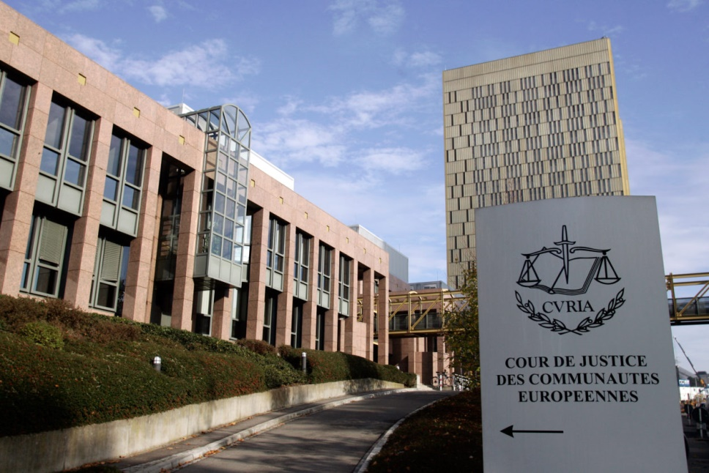
Judgment of the Court of 14 December 1979. - Regina v Maurice Donald Henn and John Frederick Ernest Darby.
Criminal law of EU
Prepared by Dmytro Taranenko

Slide 2
SUBJECT OF THE CASE
Interpretation of articles 30 and 36 of the EEC Treaty.
Comparability law of Member state to fundamental treaty.
Understanding one of the fundamental freedom “free movement of goods”

Slide 3
WHAT WERE THE PRODUCTS?

Slide 4
THE FACTS part 1
14 October 1975 a lorry arrived at the port in the United Kingdom from Rotterdam.
Lorry contained huge amount of goods with pornography materials.
Henn collected the boxes and put them into his car.
Darby waited to make arrangements with Henn to collect and distribute the films and magazines.
4 July the Court of Appeal refused to refer any questions to the Court of Justice under Article 177 of the Treaty and dismissed the appeals.

Slide 5
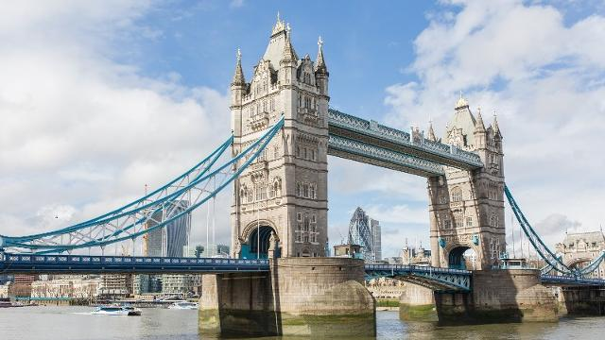
THE FACTS part 2
On 15 July they were sentenced:
Henn to eighteen months' imprisonment
Darby to two years' imprisonment.
9 November 1978 leave to appeal was granted to both appellants by an Appeal Committee of the House of Lords.
29 January 1979 the House determined that a question of interpretation of the EEC Treaty arose and should be referred to the Court of Justice.

Slide 6
1 QUESTION AND ANSWER
Does the law of MS which prohibit import of pornography equal to a quantitative restriction on imports under article 30 of EEC Traty?
Court said that national law has equivalent effect concerning quantitative restrictions on imports with the meaning of article 30 of EEC Treat.

Slide 7
2 AND 3 QUESTIONS
Does the Article 36 mean that a MS may lawfully impose prohibitions on the importation of goods from another Member State which are of an indecent or obscene character as understood by the laws of that Member State?
(i) Is the MS has a power to maintain such prohibitions in order to prevent, to guard against or to reduce the likelihood of violation of the domestic law of all constituent parts of the customs territory of the State?
(ii) Is the Member State entitled to maintain such prohibitions having regard to the national standards and characteristics if it is some differences between domestic laws of constituent parts?

Slide 8
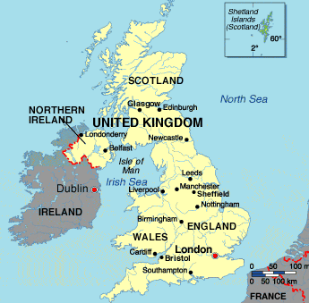
2 AND 3 ANSWERS
Article 36 means that a Member State may lawfully impose prohibitions on the importation from any other Member State of goods on grounds of public morality as understood by its domestic laws.
Such prohibitions may lawfully be applied to the whole of its national territory even if the MS has different regulation in constituent parts according article 227 EEC.

Slide 9
4, 5, 6 QUESTIONS
Does the prohibition of goods on ground of public morality can be equal to arbitrary discrimination or a disguised restriction on trade contrary to Article 36?
Does the difference in import rules and criminal rules related to possession and publication of such goods in MS means arbitrary discrimination or a disguised restriction according second sentence of Article 36?
In case of MS has prohibition imposed upon importation, but has not prohibition related to possession and publication. Does it create obligations for customs officials according Question 5?

Slide 10
4, 5, 6 ANSWERS
PART 1
The House of Lords takes account of the appellants' submissions based upon certain differences between:
the prohibition on importing the goods in question, which is absolute;
the laws in force in the various constituent parts of the United Kingdom, which appear to be less strict.
Prohibition to the import of articles which are of an indecent or obscene character does not mean discrimination on the bases of article 36, because there is no lawful trade in such goods in the United Kingdom.

Slide 11
4, 5, 6 ANSWERS
PART 2
The answer to the fourth question must therefore be that if a prohibition on the importation of goods is justifiable on grounds of public morality and if it is imposed with that purpose the enforcement of that prohibition cannot, in the absence within the Member State concerned of a lawful trade in the same goods, constitute a means of arbitrary discrimination or a disguised restriction on trade contrary to Article 36.
In these circumstances it is not necessary to answer the fifth and sixth questions.

Slide 12
7 QUESTION
Does the MS lawfully impose prohibition on the bases of Geneva Convention 1923, for the suppression of the traffic in obscene publications and the Universal Postal Convention bearing in mind the provisions of Article 234 of the Treaty?

Slide 13
7 ANSWER
Article 234 provides that the rights and obligations arising from agreements concluded before the entry into force of the Treaty between one or more Member States on the one hand, and one or more third countries on the other, are not to be affected by the provisions of the Treaty.
Member State use the reservation relating to the protection of public morality provided for in Article 36 of the Treaty, the provisions of Article 234 do not preclude that State from fulfilling the obligations arising from the Geneva Convention and from the Universal Postal Convention.

Slide 14
CONCLUSIONS
PART 1
National law has equivalent effect concerning quantitative restrictions on imports with the meaning of article 30 of EEC Treat.
MS may lawfully impose prohibitions on the importation from any other Member State of goods on grounds of public morality as understood by its domestic laws.

Slide 15
CONCLUSIONS
PART 2
Prohibition to the import of articles which are of an indecent or obscene character does not mean discrimination on the bases of article 36, because there is no lawful trade in such goods in the United Kingdom.
MS use the reservation relating to the protection of public morality provided for in Article 36 of the Treaty, the provisions of Article 234 do not preclude that State from fulfilling the obligations arising from the Geneva Convention and from the Universal Postal Convention.

