Slide 1
Kapitalizam
Seminar- debata
četvrtak, 26. listopada 2017.

Slide 2
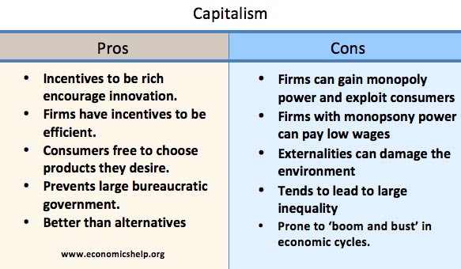
https://www.economicshelp.org/blog/5002/economics/pros-and-cons-of-capitalism/

Slide 3
A society that puts equality before freedom will get neither. A society that puts freedom before equality will get a high degree of both.” ― Milton Friedman
Economic freedom helps political freedom. If governments own the means of production and set prices, it invariably leads to a powerful state and creates a large bureaucracy which may extend into other areas of life.
Efficiency. Firms in a capitalist based society face incentives to be efficient and produce goods which are in demand. These incentives create the pressures to cut costs and avoid waste. State-owned firms often tend to be more inefficient (e.g. less willing to get rid of surplus workers and fewer incentives to try new innovative working practices.)
Innovation. Capitalism has a dynamic where entrepreneurs and firms are seeking to create and develop profitable products. Therefore, they will not be stagnant but invest in new products which may be popular with consumers. This can lead to product development and more choice of goods.
Economic growth. With firms and individuals facing incentives to be innovative and work hard, this creates a climate of innovation and economic expansion. This helps to increase real GDP and lead to improved living standards. This increased wealth enables a higher standard of living; in theory, everyone can benefit from this increased wealth, and there is a ‘trickle down effect‘ from rich to poor.
There are no better alternatives. As Winston Churchill, “It has been said that democracy is the worst form of government except all the others that have been tried.” A similar statement could apply to capitalism.

Slide 4
Capitalism is the astounding belief that the most wickedest of men will do the most wickedest of things for the greatest good of everyone.” John Maynard Keynes
Monopoly power. Private ownership of capital enables firms to gain monopoly power in product and labour markets. Firms with monopoly power can exploit their position to charge higher prices. See: Monopoly
Monopsony power. Firms with monopsony power can pay lower wages to workers. In capitalist societies, there is often great inequality between the owners of capital and those who work for firms. See: Monopsony exploitation
Social benefit ignored. A free market will ignore externalities. A profit maximising capitalist firm is likely to ignore negative externalities, such as pollution from production; this can harm living standards. Similarly, a free market economy will under-provide goods with positive externalities, such as health, public transport and education. This leads to an inefficient allocation of resources. Even supporters of capitalism will admit that government provision of certain public goods and public services are essential to maximise the potential of a capitalist society.
Inherited wealth and wealth inequality. A capitalist society is based on the legal right to private property and the ability to pass on wealth to future generations. Capitalists argue that a capitalist society is fair because you gain the rewards of your hard work. But, often people are rich, simply because they inherit wealth or are born into a privileged class. Therefore, capitalist society not only fails to create equality of outcome but also fails to provide equality of opportunity.
Inequality creates social division. Societies which are highly unequal create resentment and social division.
Diminishing marginal utility of wealth. A capitalist society argues it is good if people can earn more leading to income and wealth inequality. However, this ignores the diminishing marginal utility of wealth. A millionaire who gets an extra million sees little increase in economic welfare, but that £1 million spent on health care would provide a much bigger increase in social welfare.
Boom and bust cycles. Capitalist economies have a tendency to booms and busts with painful recessions and mass unemployment. See: Boom and bust economic cycles

