Slide 1


Assoc. Prof. Dr. Polonca Kovač
System and legal Aspects of Public Administration Reforms / PAR
in the EU and Slovenia
4 December 2014
University of Zagreb, Faculty of Law

Slide 2
Agenda
Introduction: Slovenia (SI) within EU
Theoretical and comparative aspects of PARs
In SI within EU:
PARs: phases & forms
4.-11. Focuses of different reforms: re/organization, agencies, local self-gov., HRM, TQM, BR, transparency, APA …
12. Conclusions and discussion
P. Kovač: PAR in the EU and SI 2

Slide 3
1.
Introduction:
SI within CEE & EU
P. Kovač: PAR in the EU and SI 3

Slide 4
Slovenia (SI) within (C)EE & EU
Heritage in Central Eastern Europe
Europenization
PAR strategies & umbrella laws in SI
P. Kovač: PAR in the EU and SI 4

Slide 5
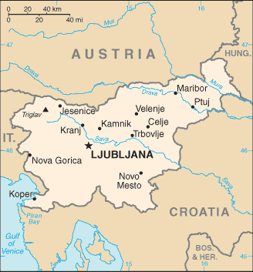
SI as a state / major transitions
  Independence 1991
  New constitutional order
  Democratization & marketization
  Accession to EU 2004
  Prevailing (adm) culture/s: Rechsstaat & neo-liberalis
  Democratic republic
  Parliamentary system
  Separation of powers
  Social state governed by law
  Unitary state
  Membership: EU (Eurozone& Schengen), OECD, NATO, UN…
  Area/pop. (13): 20,273 km2, 2,059 mio (147th)
  Democracy Index (2013): 27th/200
  GDP per capita (2012): 28,700 USD (54th)
  PS/PA: 160,000/45,000 civil servants (18%)
P. Kovač: PAR in the EU and SI 5

Slide 6
SI PA (PS?) structure (2014)
  Direct Administration
  State Administration:
    11-14 ministries (+Minister/s Portfolio) & app. 10 governm.officies
    App. 35 autonomus bodies within ministries
    58 local administrative units (8?)
  Local self-government: 212 municipalities
  Indirect Administration
  State public agencies + regional …
  Public institutes, funds …
  Independent bodies by constitution/law
P. Kovač: PAR in the EU and SI 6

Slide 7
Slovenian state system
EXECUTIVE POWER
LEGISLATIVE POWER
JUDICIAL SYSTEM
MUNICIPALITY
National
Assembly
National
Council
212
President
of the Republic
The
Government
Bank
of
Slovenia
Court
of
Auditors
Human
Rights
Ombudsman
Constitutional
Court
Supreme Court
Attorney-
General's
Office
Public
Prosecutor's
Office
Municipal
Council
Mayor
14
Higher
Public
Prosecutor's
Offices
Local Administration
Information Comissioner
Administrative
Court
Higher
Courts
Higher Labour and
Social
Court
Supervisiory Board
Governmental
Offices
Ministries
34
Autnomous Bodies within Ministries
State Revision Comission
County
Courts
Labour Courts
District
Public
Prosecutor's
Offices
Administr. Units
58
Labour and Social Court
Corruption Prevention Comission
Districts
Courts
16
Public Agencies
Public Funds
Public Institutes
Concessionaires/
PPP etc.
P. Kovač: PAR in the EU and SI 7

Slide 8
PA reforms in SI 1991-2014 →
  Independence, new constitutional order, democratization
  Accession to EU
  Marketization, increasing external & internal demand for quality, efficiency, openness, accountability …
Period-s | Reform orientation
1991-1996 | Founding new state
1997-2003 | Europeanization
2000-2004 | New organic legislation, TQM …
2005-2008 2009-2014 | Strategies on priorities and rationalization within EU
P. Kovač: PAR in the EU and SI 8

Slide 9
EU influence in PAR in CEE & SI
Since 1991, in SI 1996- PAR as part of accession process:
  PA reform as political criterion – emphasis on legislation: Civil Service Act, Public Agencies Act …
  Institutions – administrative capacity for acquis
  Regular report on progress & SIGMA peer reviews
2. Since 2004 on: SI as a MS
3. Crisis 2008,9-
P. Kovač: PAR in the EU and SI 9

Slide 10
2.
Theoretical and comparative aspects in PARs
P. Kovač: PAR in the EU and SI 10

Slide 11
Modernization of PA – theories
Rechsstaat / Weberian State
From strict authoritative functioning to partnership
80´s New Public Management – introduction of private sector principles/methods, efficiency of management, democracy & user orientation (economic values)
  Neo-Weberian State &
  Good (Public) Governance (legal, democratic, ecological, social values): openness, transparency, citizens’ rights protection, etics, environment protection, citizens’ engagement and participation, responsiveness, etc.
P. Kovač: PAR in the EU and SI 11

Slide 12
Modernization of PA - documents
Basic sources:
  The World Bank
  OECD
  Initial EC‘s White Paper on European Governance (2001)
  Later: Good Adm by EU ombudsman‘s Code (2001- )
  Today: Article 41 of EU Charter (2010)
P. Kovač: PAR in the EU and SI 12

Slide 13
Basic goals of PAR/modernization
(in EU …)
To plan &control the implementation of public policies
To protect public interests; regulate fields where the
market would not function in that respect
To create an enabling environment to stimulate
entrepreneurship and investment
(economic progress and sustainable social development)
P. Kovač: PAR in the EU and SI 13

Slide 14
Dimensions of PAR
Functional
Organizational
Managerial:
  HRM
  Public finances
  IT …
Processual?
P. Kovač: PAR in the EU and SI 14

Slide 15

3 generations of polit-adm. procedures (Barnes, 08)
Type of process | Ground | Method of problem-solving/competences
Ind. authoritative decision-making | Division of powers since 19th century | Judicial/ Legal knowledge
Executive-adm. implementational decision-making | Co.decision-making at national and EU levels after WW2 | Normative / Legal knowledge, organisational , managerial, etc. skills
Public policy cycle, societal dialogue | Coordination of interests at policies‘ design/implement. | Administrative / Altruism (p. benefit), (human) dialogue, multitasking, ADR skills, e-communication, etc.
Good PA = participatory + efficient

Slide 16
NPM as reforms incentive
Private sector (entrepreneurial concept/methods)
        Democratization
        Effectiveness, efficiency
        ⇓
        Public sector (public interest, legality …)
conflict?
Steering
Rowing
NPM = Hybrid of Management and
Classical Core of Values in PA (Hood)
P. Kovač: PAR in the EU and SI 16

Slide 17

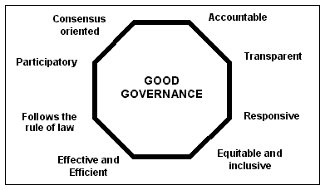
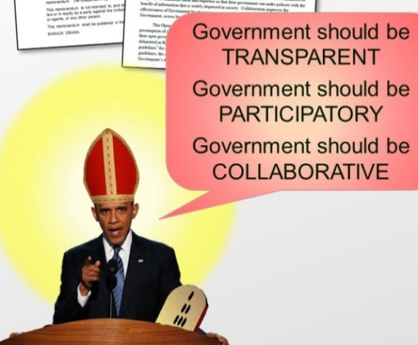
Good Governance = GG
  Building blocks: efficiency & participative strategic planning
  = sustainable development
  Rule of law: fair & impartial legal system, HR/minorities, no corruption, judicial review of PA
Economic growth
Social cohesion
Good Governance
P. Kovač: PAR in the EU and SI 17

Slide 18

Effects of PARs globalwide under NPM/GG
Success
Reduction of public expenditure in GD
Efficiency measurements, output control
Client orientation
Failure
Public values …
Change in public service – culture …
P. Kovač: PAR in the EU and SI 18

Slide 19
Periods of PARs in CEE (Lane, 1995)
Transformation – establishment of new system with several political parties, local self-government etc.
Consolidation – new political system is stabilized, opportunities for privatisation opened, denationalisation and implementing free market elements
Modernisation – the actual reform process is in place, (changed role of public institutions, reorganisation, gradual deregulation)
Adaptation – efficiency and effectiveness introduced, a set of changes regarding legislation and regulation.
P. Kovač: PAR in the EU and SI 19

Slide 20
NPM and PARs in CEE – issues to be adressed
(Pollitt and Bouckaert, 2004)
The structure of the state: vertical/horizontal dispersion of the authority; coordinaton
The nature of the executive government = coalitions; gains?
Minister/mandarin relations; civil servants also policy makers? Politicization?
The prevailing administrative culture; Rechtsstaat - central force, the public interest - necessary evil?
The nature of policy advice = distinctions Western vs. post-socialist administrative systems
P. Kovač: PAR in the EU and SI 20

Slide 21
PAR focuses in CEE / SI
Pollitt & Bouckaert, 2004/5
Rationalization
Europenization
Establishing the state
Core claim elements of Neo-Weberianism in Slovenia and broader | General PAR orientation 1996-2014 in CEE/SI
1. “Weberian” elements
State as the main facilitator of society | Medium ?
The role of representative democracy | Medium
Basic principles of administrative law | High
A public service with a distinctive status | Medium ?
2. “Neo-Weberian” / good governance
External orientation towards citizens | High ?
Rationalization with ex-post control | Medium ???
Professionalism of public service | High
P. Kovač: PAR in the EU and SI 21

Slide 22

SIGMA (1998-): European Adm. Space
Basic guidelines (EC principles):
legality, impartiality, procedural fairness
Reliability and predictability (legal certainty)
Openness & transparency
Accountability & liability
Efficiency & effectiveness
P. Kovač: PAR in the EU and SI 22

Slide 23
Principles of modern PA
  CLASSICAL:
  legality
  objectivity
  professionalism
  political neutrality
  MODERN AS ADDED VALUE:
  customer orientation
  open and transparent government
  effectiveness, efficiency, economy …
  satisfaction of employees …
P. Kovač: PAR in the EU and SI 23

Slide 24
GG / GA Principles 1/2 (Sever et al., 2013)
Good Governance Classical Principles | Good Administration Classical Principles
Human rights protection Rule of law Reliability and predictability Coherence Equity Ethical behaviour Combating corruption Decision-making in reasonable time | Lawfulness Equality, fairness, non-discrimination Impartiality, proportionality, certainty Hearing, access to info, privacy Use of language Assistance and representation Reasoning and indication of remedies Compensation of damages
P. Kovač: PAR in the EU and SI 24

Slide 25
GG / GA Principles 2/2 (Sever et al., 2013)
Good Governance Mgmt/GG Principles | Good Administration Mgmt/GG Principles
Transparency, openness, participation Technical and managerial competence Organizational capacity Accountability, effectiveness, efficiency Simplification of procedures Responsiveness to people‘s needs | Participation Transparency Effectiveness, efficiency, taking action within a reasonable time limit
P. Kovač: PAR in the EU and SI 25

Slide 26
SIGMA: Principles of PA (Nov 2014)
STRATEGIC FRAMEWORK OF PAR = 5 principles
POLICY DEVELOPMENT AND CO-ORDINATION = 12
PUBLIC SERVICE AND HRM = 7
ACCOUNTABILITY = 5
SERVICE DELIVERY = 4
PUBLIC FINANCIAL MANAGEMENT = 16
P. Kovač: PAR in the EU and SI 26

Slide 27
SIGMA: Principles of PA (Nov 2014)
STRATEGIC FRAMEWORK OF PUBLIC ADMINISTRATION REFORM
Key requirement: The leadership of public administration reform is established and the strategic framework provides the basis for implementing prioritised and sequenced reform activities aligned with the Government’s financial circumstances
Principle 1: The Government has developed and enacted an effective public administration reform agenda which addresses key challenges.
Principle 2: Public administration reform is purposefully implemented; reform outcome targets are set and regularly monitored.
Principle 3: Financial sustainability of public administration reform is ensured.
Key requirement: Public administration reform management enables guiding and steering reforms, determines the accountability for implementation and ensures the professional administration needed for reform implementation
Principle 4: PAR has robust and functioning co-ordination structures at both the political and administrative level to steer and manage the reform design and implementation process.
Principle 5: One leading institution has responsibility and capacity to manage the reform process; involved institutions have clear accountability and reform implementation capacity.
P. Kovač: PAR in the EU and SI 27

Slide 28
SIGMA: Principles of PA (Nov 2014)
ACCOUNTABILITY
Key requirement: Proper mechanisms are in place to ensure accountability of state administration bodies, including liability and transparency.
Principle 1: The overall organisation of central government is rational, follows adequate policies and regulations and provides for appropriate internal, political, judicial, social and independent accountability.
Principle 2: The right to access public information is enacted in legislation and consistently applied in practice.
Principle 3: Functioning mechanisms are in place to protect both the rights of the individual to good administration and the public interest.
Principle 4: Fair treatment in administrative disputes is guaranteed by internal administrative appeals and judicial reviews.
Principle 5: The public authorities assume liability in cases of wrongdoing and guarantee redress and/or adequate compensation.
P. Kovač: PAR in the EU and SI 28

Slide 29
SIGMA: Principles of PA (Nov 2014)
SERVICE DELIVERY
Key requirement: Administration is citizen-oriented; the quality and accessibility of public services is ensured.
Principle 1: Policy for citizen-oriented state administration is in place and applied.
Principle 2: Good administration is a key policy objective underpinning the delivery of public service, enacted in legislation and applied consistently in practice.
Principle 3: Mechanisms for ensuring the quality of public service are in place.
Principle 4: The accessibility of public services is ensured.
P. Kovač: PAR in the EU and SI 29

Slide 30
Overall PA theories & main elements
Model/ elements | Weberian PA | NPM and post-NPM | NWS | Good Governance
Main period | 19th and the beginning of 20th c. | From 80s in 20th century on | Late 90s and presently | After 2000s and on
Main principles | Legality, equality, responsibility, formalism, rationalization… | Efficiency and effectiveness, economy, users’ orientation | Efficiency and effectiveness, state governed by law and social welfare | Participation, transparency, accountability, efficiency …
Role of the state | All mighty: state solving all societal problems | Minimal: state ensures, not provides public services and products | Stronger: state removes market deficiencies, coordinating societal subsystems | Collaborative: government develops partnerships for co-decision-making
Deficiencies | Does not function in rapidly changing and complex society, not acknowledging non classical structures beyond traditional division of powers, self-centrism, etc. | Does not function if lack of authorized and highly ethical public officials, endangered equality, corruption, corporatism, democracy erosion… | Rediscovering prior existing modes of governance as new ones (rule of law, legitimacy, etc.) | Does not function if societal subsystems immature, favors more active stakeholders, lack of democratic control due to delegation of power
Conducts and organization of PA | Efficient bureaucracy, hierarchy for clear responsibility | Privatization, deregulation, decentralization, etc. | Back to effective public policies implementation | State governed by law thorough delegation, coordination and participation
Relation of PA toward politics | Apolitization | Neutrality, apolitical management | Improving capacity through PA, with legally limiting polity | Hand in hand for common public good
P. Kovač: PAR in the EU and SI 30

Slide 31
3.
Phases, focuces and forms of PARs in SI 1991-2014-
P. Kovač: PAR in the EU and SI 31

Slide 32
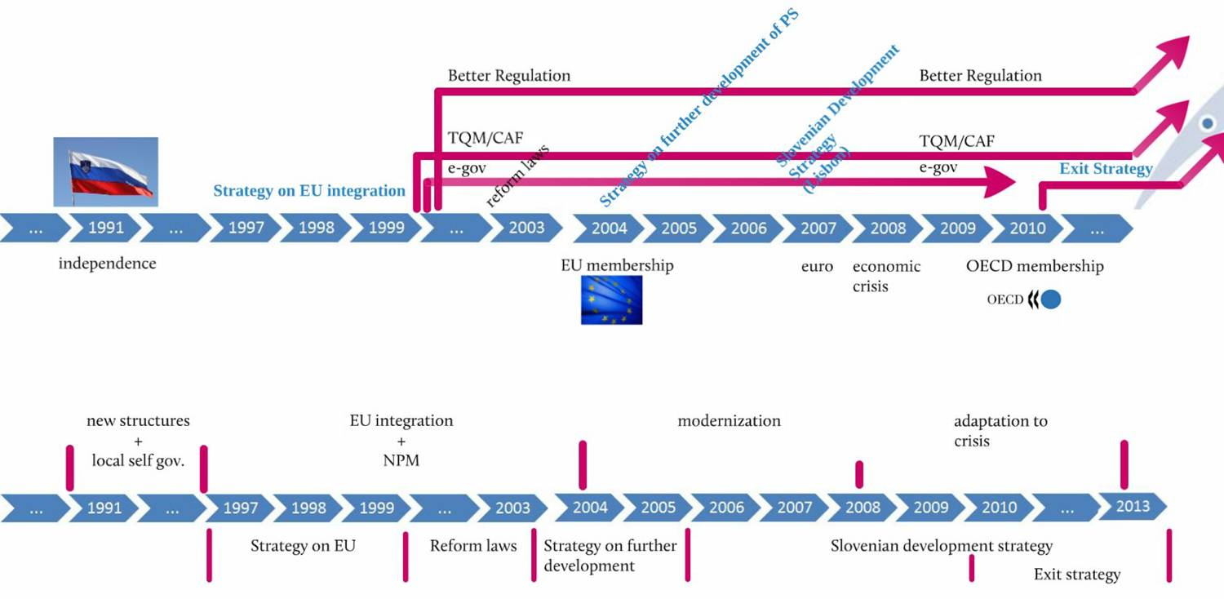
Focuses and phases of PARs in SI = 1991-2014
2014-!?
P. Kovač: PAR in the EU and SI 32

Slide 33
PARs in SI: pendulum?
Strategy (adopted) | Adopted; by | Period
Strategy for EU Accession | 1996; Parliament (left wing- driven, but overall political consensus) | 1997-99
Umbrella laws (State PA, Agencies, Inspection, Wages, Civil Service, etc.) | 2002; Parliament (left wing-driven, but overall political consensus) | 2000-03
Strategy on Further Development of the Slovene Public Sector | 2003; Government (left) | (2000-)2003-05
Slovenia’s Development Strategy | 2004; Governments (left & right) | 2005-13
Exit (from economic crisis) Strategy | 2010; Government (left) | 2010-13
Draft - The Origins of Further Development and Org. and Normative Regulation of the Public Sector | 2011; Government (left) | 2011-12
Changed jurisdiction of ministries, agencies and funds & State Adm. Act amendment | 2012 Government & Parliament (right wing majority) | 2012-
Origins for further PA development Strategy | Government (left) | 2014-20
P. Kovač: PAR in the EU and SI 33

Slide 34
New legislation since 2000-
State Administration Act (ZDU)
Inspection and Supervision Act (ZIN)
Novelties in Local Self-gov. Act (ZLS)
Public Agencies Act (ZJA)
Public Funds Act (ZJS)
Public Institutes Act (ZZ)
Civil Service Act (ZJU)
Law on Wages in Public Sector (ZSPJS)
Public Finances Act (ZJF)
General Administrative Procedure Act (ZUP)
Law on E-business and E-signature (ZEPEP)
Freedom of Information Access Act (ZDIJZ) …
Direct PA
Indirect PA
PS
PA
P. Kovač: PAR in the EU and SI 34

Slide 35
4.
Re/organizations in SI PA
P. Kovač: PAR in the EU and SI 35

Slide 36
Zakon o Vladi RS
vladne službe (10)
Zakon o
inšpekcijskem
nadzoru
Zakon o
državni upravi
ministrstva (14)
organi v sestavi (35)
inšpektorati (15/35)
Zakon o javnih agencijah
upravne enote (58)
Zakon o (javnih?) zavodih
Zakon o lokalni
samoupravi
Zakon o javnih skladih
občine (212)
P. Kovač: PAR in the EU and SI 36

Slide 37
State Administration Act (ZDU-1)
2002-
Harmonized principles: customer orientation, apolitization …
Adm. tasks: systems approach within SA and PA (LSG, agencies …)
SA organs: ministries, its agencies, adm. units = coordination!
Leadership in M: politics & professionalism
P. Kovač: PAR in the EU and SI 37

Slide 38
Organizational forms in SI & autonomy
Ministry
Ministry
Autonomy
Government
Public agencies
Private “A”
Governm. Office
Ministry
Autonomous Body
Ministry
Legend:
Guidelines&
supervision
Directorate
Ministry
Agency
Department
Organizational form in a function of aimed role in PA system & entity’s taks!?
P. Kovač: PAR in the EU and SI 38

Slide 39
Internal organization and leadership in the ministry
Politics
Minister
Professionalism
State Secretary (0-2 per M)
Director General
Director General
Director General
Secreatry General
Director
DIRECTORATE
SECRETARIAT
BODIES within M
(such as inspectorates …)
SECTOR
SERVICE
P. Kovač: PAR in the EU and SI 39

Slide 40
Agencies=bodies within ministries
All "executive agencies?
  Internal part of the ministry with relative/semi autonomy (professional, personnel, finantial)
  Types (just by name!): inspectorate, agency, administration, office – possible territorial deconcentration
  Regulated by State Adm Act (ZDU-1) / gov. decree
  Tasks: executive (individual) authorities & services
  Reasons to establish by law (ZDU-1):
    More efficient & expedient performance, with users’ fees
    Permanent/direct political supervision not necessary /inappropriate ...
P. Kovač: PAR in the EU and SI 40
Notes:
40

Slide 41
Inspections Act (ZIN)
2002-
Harmonized principles: state & LSG inspections!; apolitization …
Coordination = Inspection Council for state inspections
Special adm. procedure
Prevention ….. Measures ….Misdemenours
P. Kovač: PAR in the EU and SI 41

Slide 42
Public services providers outside SA/LSG = 30 % of EU GDP!
Standards with regard to the services of general interest:
Such as: telecomunication, energy distribution, post .... and non-economic services
Providers in SI: SA + LSG or public institute/enterprise, PPP (contracts & equity)
Principles: universality (universal access), affordability, high-quality, consumer protection ...
Effective legal protection of consumers in their relations with powerfull private providers – adm. authority (regulatory agency) resolving conflicts!
P. Kovač: PAR in the EU and SI 42

Slide 43
5.
Agencification in SI within EU
P. Kovač: PAR in the EU and SI 43

Slide 44
Types of agencies in SI by status
Agencies as body within ministries (executive, next step)
Public agencies (regulatory & executive, legal person)= type 2
Other independent bodies
Internal privatization
External privatization
P. Kovač: PAR in the EU and SI 44

Slide 45
Public agencies (PAG=type 2)
EU!!!
  Delegation of PA from M: Art. 121 of Constitution
  1st PAG in SI in 1994 (Securities Market Agency)
  Organic law 2002 (PAG Act, ZJA & ZDU-1) & specific law
  Tasks: no exception by law (de facto not foreign affairs ...)
    Regulatory & executive & supervison & development
    Authorities & services
  Reasons to establish by law (ZJA & ZDU-1):
    Efficient and expedient performance, user-cofunding
    Permanent/direct political control unnecessary or inappropriate
    Self-regulation
P. Kovač: PAR in the EU and SI 45

Slide 46
Agencification (type 2) in SI in No.
Period | No. of new PAGs | Sum
-2000 (1994-) | 1 | 1
2000–2004 | 7 | 8
2005–2008 | 3 | 11
2009–2012 | 6 | 17
2013-2014 | -2 (+1, -1, 2 merged …) | 16 …
P. Kovač: PAR in the EU and SI 46

Slide 47
Agencies in M v. PAG
Direct PA
Indirect PA
 | Agencies in M (OVSM) | Public agencies (JA)
Established by | Governmental acts | Specific law by Parliament
Organic law criteria | Efficiency & depolitization | Efficiency & depolitization
Tasks Comparative type | Executive 1 | Regulatory, executive … 2 & recently more 1
No. 2011-14 (13) | 34-39 (34) | 15-19 (16)
No. of em. 2013 | All M=31,967/Civil=14,859 In M’s ag.s=7,205 (Army 7,477, Police 8,439, Prison 865) | All app. 1,000 (3 PAGs not in gov. Plan=180)
=
=?
=?
!
!
=?
6%SA
=?
50%M
Big differences: 3-2,500
Differences:
3-250

Slide 48
Direct PA
Indirect PA
Agencies in M v. PAG
 | Agencies in M (OVSM) | Public agencies (JA)
Supervison | Direct ministry | Parent / field ministry/ies
Legal personality | No | Yes
Financial autonomy Resources | Yes, direct budgetary user Budget, rarely fees | Yes, indirect budget user Budget & fees
Head nomination Civil service | Government/open competition Yes, all (head+officials+staff) | Agency Council Except director partial CSA
Legality review | Adm. appeal within ministry, judicial review | Rarely M aproval for general acts & usually no adm.appeal, judicial ind. acts review
Continuity | In principle yes | “Classical regulatory” yes, other very often changes
=
=?
=?
=
=
=?
PAGs for
definite period?
48

Slide 49
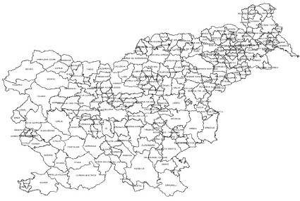
6.
Local Self-Government (LSG)
in SI within EU
P. Kovač: PAR in the EU and SI 49

Slide 50
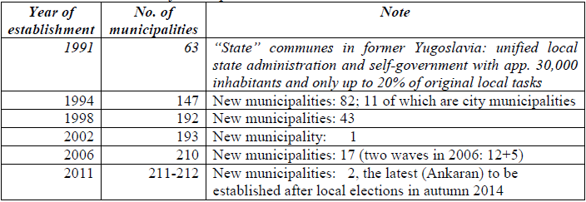
LSG development in SI
Former Yugoslavia: 1963-1990
LS Reform after RS Independence: 1991-1994
Further fragmentation: 1994-2014-:
  Only attempts of regionalisation
  LSG v. local state adm. (SA) interplay!?
By ConstitutionalCourt!

Slide 51
Good public governance locally
Local self-government as a key democracy system (vertical division of powers), but inevitably part of PA = factor of social development
Local self-government comprises a political as well as an administrative dimension
Public sector
Public Adm
Self-government
State Adm

Slide 52
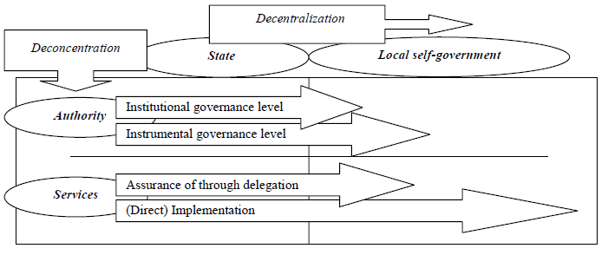
Harmonization / integrating of
Local Self-government & State Adm
Decentralisation of local self-government v. deconcentration of state administration
Basic criteria to (re)design local adm. structure:
State Adm
Local SelfGov
Authority
Services
P. Kovač: PAR in the EU and SI 52

Slide 53
7.
Human Resource Management (HRM)/Civil Service in SI within EU
P. Kovač: PAR in the EU and SI 53

Slide 54
Civil Service Act (ZJU)
2002/3- main novelties:
Human resources planning
Job classification=transparent system of titles, positions and statuses and promotion
Civil Servants: “officials” and “staff”
Open competition for officials vacancies
Increasing flexibility, moving closer to labour law (possibilities of dismissal for bad performance, violation of contract or in cases of staff-reduction) …
Obligatory HRM instruments (Adm. Academy, annual interviews, internal labour market …)
Special regulation for top managers
Obligatory professional exams for civil servants !?
P. Kovač: PAR in the EU and SI 54

Slide 55
Civil service & unified PS pays
(2013-)
Salary grade | Base salary (in €) | Salary grade | Base salary (in €)
1 | 440.38 | 34 | 1,606.68
2 | 458.00 | 35 | 1,670.94
3 | 476.31 | 36 | 1,737.79
4 | 495.37 | 37 | 1,807.29
5 | 515.18 | 38 | 1,879.59
6 | 535.80 | 39 | 1,954.78
7 | 557.21 | 40 | 2,032.98
8 | 579.51 | 41 | 2,114.29
9 | 602.70 | 42 | 2,198.84
10 | 626.81 | 43 | 2,286.81
11 | 651.88 | 44 | 2,378.28
12 | 677.95 | 45 | 2,473.41
13 | 705.06 | 46 | 2,572.34
14 | 733.27 | 47 | 2,675.25
15 | 762.60 | 48 | 2,782.25
16 | 793.10 | 49 | 2,893.54
17 | 824.84 | 50 | 3,009.28
18 | 857.83 | 51 | 3,129.66
19 | 892.13 | 52 | 3,254.84
20 | 927.82 | 53 | 3,385.03
21 | 964.94 | 54 | 3,520.44
22 | 1,003.54 | 55 | 3,661.25
23 | 1,043.68 | 56 | 3,807.69
24 | 1,085.43 | 57 | 3,960.02
25 | 1,128.83 | 58 | 4,118.41
26 | 1,173.99 | 59 | 4,283.14
27 | 1,220.94 | 60 | 4,454.47
28 | 1,269.78 | 61 | 4,632.64
29 | 1,320.58 | 62 | 4,817.96
30 | 1,373.40 | 63 | 5,010.67
31 | 1,428.34 | 64 | 5,211.10
32 | 1,485.46 | 65 | 5,419.54
33 | 1,544.88
    State administration: 35.000
    Local administration: 4.500
    Holders of PA authority: 5.500
    Other state bodies: 5.000
    Public institutions:
      ChildCare&Education: 57.000
      Health care: 32.000
      Social care: 11.000
      Culture: 6.000
      Research: 5.000
45.000
160.000
111.000
P. Kovač: PAR in the EU and SI 55
Notes:
55

Slide 56
Pay System in PS Act (ZSPJS)
2002 ... 2010!
Unified PS system
Pay groups A – J in podskupine; 9 tarif classes
  A Funkcije
  B Poslovodni organi pri uporabnikih proračuna
  C Uradniki
  D Vzgoja, izobraževanje in šport
  E Zdravstvo
  F Socialno varstvo
  G Kultura in informiranje
  H Znanost
  I Javne agencije, skladi, zavodi, javno gospodarski zavodi
  J Spremljajoča delovna mesta za ves javni sektor
P. Kovač: PAR in the EU and SI 56

Slide 57
Selection of top mgmt in PA in SI
candidates “shortlist”
☺
Comission (3-)
Minister
Officials Council (12)
President
Government
Officials
Trade Unions
+ Compulsory special mgmt training (8 days)
P. Kovač: PAR in the EU and SI 57

Slide 58
8.
From better / smart regulation
in SI within EU to e-gov …
P. Kovač: PAR in the EU and SI 58

Slide 59
Smart (Better) Regulation – EU &
Edinburgh Summit (1992)
Lisbon Strategy (2000)
Mandelkern report (2001) – 4-6% BDP of red tape
White Paper on Good Governance (EC, 2001)
Regulatory Impact Analysis (RIA) (EC, 2002, 2006 Committee …)
Public consultation standards (EC, 2002)
EU Council (2007) –25% reduction in EU acquis …
In MS!!! = SI Programme of removal of adm. barriers
P. Kovač: PAR in the EU and SI 59

Slide 60
Regulatory loop (Virant, 2009)
Regulatory costs
Public sector
Private sector
Businesses
Direct financial costs (taxes, etc.)
Capital costs
Indirect costs / efficiency costs
Citizens / households
Costs of administrative compliance with regulation
ADM. BURDEN
Ex-ante RIA
POLICY DESIGN
Day to day evaluation
IMPLEMENTATION
Ex-post RIA
POLICY REVISION
Smart/better regulation goals:
Policies‘ optimization
Welfare
Competitiveness
P. Kovač: PAR in the EU and SI 60

Slide 61
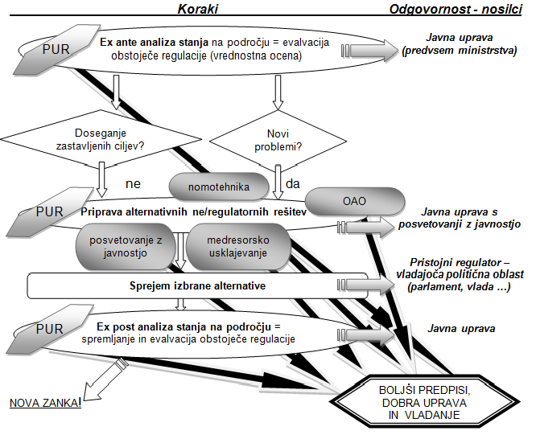
SI RIA/PUR (Parliament Resolution 2009)
Resolution (parliament) on normative activity
Gov. Rules of procedure
Ministry PA =guidelines, portals…
P. Kovač: PAR in the EU and SI 61

Slide 62
Removal od adm. barriers
G2B:
  No additional acts for entrepreneuirals
  Working permits and visas procedures incorporated
  Registration time reduced
  One-stop-shop for establishing the firm …
G2C:
  Exchange of information from office records between administrative bodies
  Administrative taxes by mobile telephone or credit cards
  Special portal with the catalogue of life events, standard forms for administrative procedures …
G2G:
  Data bases (opening and inter-connecting), informatization of processess
P. Kovač: PAR in the EU and SI 62

Slide 63
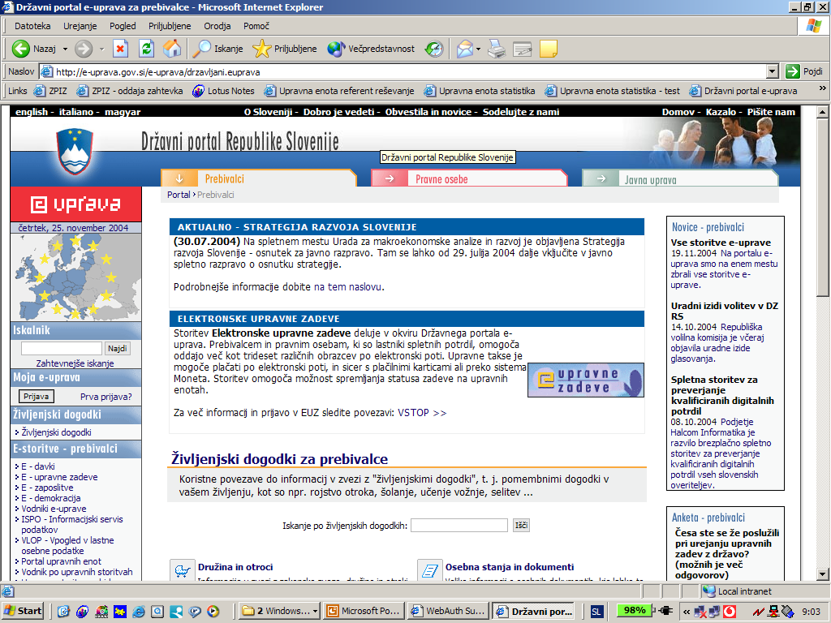
E-gov in SI
Portal “e-government” services for citizens (tax report …)
Services for businesses, standardization of information/forms …
http://e-uprava.gov.si/e-uprava/
P. Kovač: PAR in the EU and SI 63

Slide 64
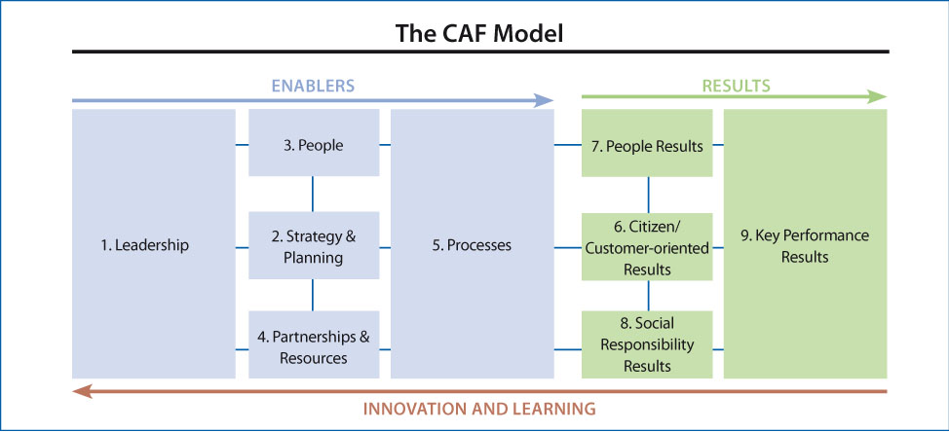
9.
TQM in SI within EU
P. Kovač: PAR in the EU and SI 64

Slide 65
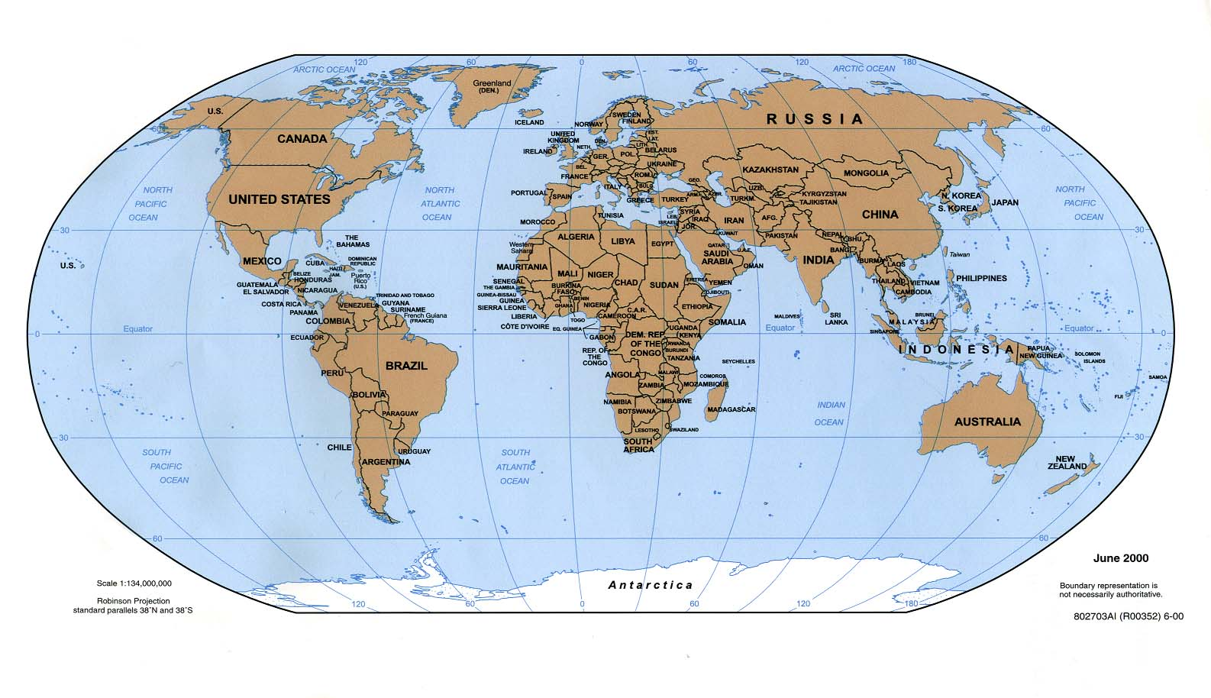
Inter- and national awards in TQM
European Quality Award, 1992,
in SI PRSPO, 1998-
Deming, 1951
Malcolm Baldrige NQA, 1988
P. Kovač: PAR in the EU and SI 65

Slide 66
TQM in SI PAR strategies …
GOVERNMENTAL POLICY FOR THE PUBLIC SECTOR
PRIORITY AREAS AND AIMS
POSITION STATEMENT ON THE QUALITY AND COMPETITIVENESS OF PRODUCTS
Markets (Slovenian economy)
- WELL-BEING
- COMPETITIVENESS ON FOREIGN EU AND GLOBAL MARKETS
STRATEGIC PLAN FOR THE IMPLEMENTATION OF THE PA REFORM PROJECT 1997─1999
  LEGALITY, OPENESS, TRANSPARENCY, NEUTRALITY
MONITORING AIMS AND RESULTS
3-E
EU-COMPARED LIVING CONDITIONS
PAR
QUALITY POLICY OF THE SLOVENIAN STATE AND PUBLIC ADMINISTRATION 2003
SLOVENIA`S DEVELOPMENT STRATEGY 2004 (till 2013)
  COMPETITIVENESS AND GROWTH OF THE MARKET
EFFICIENT USE OF KNOW-HOW FOR GROWTH AND NEW JOBS
EFFECTIVE AND LESS EXPENSIVE GOVERNMENT
MODERN WELFARE STATE
SUSTAINABLE DEVELOPMENT
Economy
AND
the state
STRATEGY ON FURTHER DEVELOPMENT OF THE SLOVENIAN PUBLIC SECTOR 2003─20052006─2013
STRATEGY ON PA DEVLOPMENT 2014-2020
P. Kovač: PAR in the EU and SI 66
P. Kovač: PAR in the EU and SI 66

Slide 67
QM projects 2000-2014
Portal with the Catalogue of Life Events
Standardization of Applications; Paying Administrative Fees by Credit Cards; Data Exchange from Official Databases …
Good Practices – Governmental Decree = citizen charter
(obligatory: annual customer satisfaction surveys (all PA) and monthly Barometer …)
Performance Measurement in PA
Conferences on QM, Good Practices and CAF
TQM tools: ISO (since 1999) and CAF (2002-) …
P. Kovač: PAR in the EU and SI 67

Slide 68
Usage of TQM tools in SI (2008)
TQM tool | Used in the Slovenian PA from | Estimated no. of users in 2008 | % of users in state and non-state A | % of users at levels of central/local
ISO 9000 standards | 1996 (more from 2000 on) | 50 | State: 90 Non-state: 10 | Central: 10 Local: 90
CAF model | 2002 | 100 | State: 80 Non-state: 20 | Central: 20 Local: 80
EFQM model | 2004 | 20 | State: 100 Non-state: 0 | Central: 10 Local: 90
Satisfaction Surveys (annual) | 2005 | 400 obliged, carried out in cca 150 | State: 80 Non-state: 20 | Central: 35 Local: 65
Barometer of Quality (monthly) | 2006 | 150 | State: 100 Non-state: 0 | Central: 10 Local: 90
P. Kovač: PAR in the EU and SI 68

Slide 69
CAF in EU & SI
Year | Activity
1998 | EUPAN (European Public Administration Network) initiative
2000 | 1st CAF conference (Portugal)
2001 | European CAF Resource Center at EIPA, Maastricht (NL)
2002 | Model CAF 2002, 2nd conference (DK)
2003 | 1st CAF users assembly (I), analysis
2004 | 3rd conference (NL)
2005 | 2nd CAF users assembly (Lx), analysis 2
2006 | 4th conference (FL), edition »CAF Works«
2007 | 3rd CAF users assembly
2008 | 5th conference (F)
2010 | 4th CAF users assembly (RO)
2011 | Study on CAF use 2011
2012 | 5th CAF users assembly (N)
2013 | New CAF version
No. of users (2013):
Italy 414; B 313; DK 250;
PL 160; A 93; SI 70; CR 3?
P. Kovač: PAR in the EU and SI 69

Slide 70
10.
Transparency –
access to public info in EU and SI
P. Kovač: PAR in the EU and SI 70

Slide 71


Systems of ind/general in
RTI legislation & case law?
 | Access to one’s file in individual AP | Access to public information in general documents
ECHR | Art. 6, fair trial | Art. 10, freedom of expression, Res 81: reasonable time&leg.protection, Rec02
EU Omb. Code | Arts. 20 & 22, on individual measures affecting the party (and Art. 24, documenting) | Arts. 21 and 23, for general access to documents (Reg. 1049/2001)
EU Char | Art. 41,good administration | Art. 42, right of access to documents
(most) National laws | General constitutional guarantees (equality, defense, etc.) APA (552 US, 37 Austrian, 82 Slov, 84 Cro) | Constitutional right (freedom of expression) RTI Law (or part of the Const/APA) = in 2014 in 100 countries Subsidiary APA
JMv.CZ, TKv.H
Tradax
Cement, Soda Ash
P. Kovač: PAR in the EU and SI 71

Slide 72
Key comparison: law/praxis/trend
 | RTI’s AP aspect | USA | IRL | S | D | A | SI | CRO
1 | Legitimacy (applicants + accessory) & obliged
2 | Formality (application, adm. act)
3 | Timing (limits set, adm.silence)
4 | L.protection (IC & court)
P. Kovač: PAR in the EU and SI 72

Slide 73
11.
APA in SI within EU = a tool for Good Administration (GA)!
P. Kovač: PAR in the EU and SI 73

Slide 74
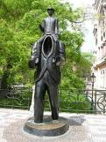
APs functions in theory
  To support substantive law or autonomus?
  General:
  Ensure the protection of human rights
  Allow participation
  Provide for balancing of interests
  Serve administrative transparency and clarity
  Make cooperation among various actors possible
  Enhance administrative efficacy
P. Kovač: PAR in the EU and SI 74

Slide 75

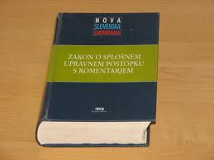
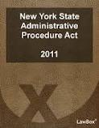

Key novelties in new GAPAs
Converging ratio: state/p.interest & citizens’ rights
Scope: In p. services (real acts, SGI) & adm. contracts
Proportionality & hearing; access data & protection
Ex officio investigation of facts + enforcement Principles
E-government, time limits … Simplifications
Limitation of remedies (reasoning, but pro actione)
ADR, alternative dispute resolution (mediation)
P. Kovač: PAR in the EU and SI 75

Slide 76


ZUP in SI
    Zakon o splošnem upravnem postopku (ZUP):
      ZUP, Ur. l. RS, št. 80/99, velja od aprila 2000
      ZUP-A, Ur. l. RS, št. 70/00
      ZUP-B, Ur. l. RS, št. 52/02
      ZUP-C, Ur. l. RS, št. 73/04
      ZUP-D, Ur. l. RS, št. 119/05
      ZUS-1, Ur. l. RS, št. 105/06
      ZUP-E, Ur. l. RS, št. 126/07
      ZUP-F, Ur. l. RS, št. 65/08
      ZUP-G, Ur. l. RS, št. 8/10
      ZUP-H, Ur. l. RS, št. 82/13
      ZUP-I …. ZUP-1 ???
P. Kovač: PAR in the EU and SI 76
Notes:
76

Slide 77
EU Charter 41/Right to Good Adm.
Every person has the right to have his or her affairs handled impartially, fairly and within a reasonable time by the Institutions, bodies and agencies of the Union. 2. …includes:
  (a) the right of every person to be heard, before any ind. measure which would affect him/her adversely is taken; (b) the right of every person to have access to his or her file, while respecting the legitimate interests of confidentiality…; (c) the obligation of the adm. to give reasons for its decisions.
Every person … the right to … damage caused by its Institutions …Every person may write to the Institutions of the Union in one of the languages of the Constitution and … answer in the same...
GA: legal +!!! proper, non-maladm., constitutional rights, effectiveness, partnerships, new IT …
P. Kovač: PAR in the EU and SI 77

Slide 78
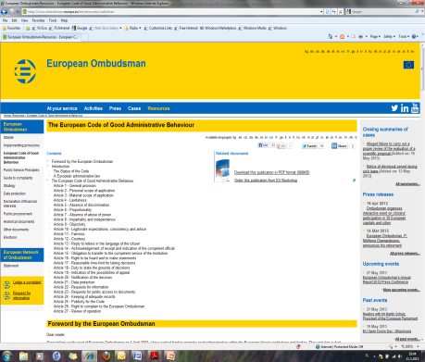
EU Ombudsman Code 2001/05/12
  Art. 4,6,7: lawfulness, proportionality, absence of abuse of power
  Art. 5,8,9: non-discrimin., impartiality, independence, objectivity
  Art. 10,12,14,15: legitim. expectations, consistency, advice, fairness,
  courtesy, receipt, indication/transfer of/to competent
  Art. 13: reply in own language
  Art. 16: right to be heard and make statements
  Art. 20-24: acc. (pub.) info, data protection, notification, records
  Art. 17: reasonable time-limit
  Art. 18: reasoning decision
  Art. 19,26: indicate appeal & complaint to Omb.
P. Kovač: PAR in the EU and SI 78

Slide 79
EU APA 2014-5? - European Parliament Resolution of 15 January 2013 with six recommendations to the Commission for a Law on AP
3. Recommendation (on the nine general principles)
  Principle of lawfulness : adm. act in accordance with the law… never arbitrary… by the public interest.
  Non-discrimination and equal treatment
  Proportionality
  Impartiality
  Consistency and legitimate expectations
  Respect for privacy
  Fairness
  Transparency
  Efficiency and service
P. Kovač: PAR in the EU and SI 79

Slide 80
EU APA 2014-5? – EP Recommendations 2013
4. Recommendation (ten rules)
  on the initiation of the administrative procedure
  on the acknowledgment of receipt
  on the impartiality of administrative decisions
  on the right to be heard
  on the right to have access to one's file
  on time-limits
  on the form of administrative decisions
  on the duty to state reasons
  on the notification of administrative decisions
  on the indication of remedies available
P. Kovač: PAR in the EU and SI 80

Slide 81
Principles in selected C/SEE APAs (Sever et al., 2013, NISPAcee)
P. Kovač: PAR in the EU and SI 81

Slide 82


Conclusion= ratio of modern PA/AP
Legal protection of weaker in unilateral adm. relation (legal certainty, defense rights, dignity)
Efective public policies’ implementation by confronting public and private interests with even economic progress
Connecting and participatory tool …
(Only) auxilliary? nature to strive for substantive law goals
Balancing formalism acc. to level of conflicts
If a public law entitlement is ensured in legislation,
it shall provide suitable (not too formal) procedure too
to effectively guarantee legal protection!
P. Kovač: PAR in the EU and SI 82

Slide 83
12.
Conclusions
P. Kovač: PAR in the EU and SI 83

Slide 84
Impact of political/system’s stability/coherence & impacts
Taking into account transitional status of state:
  Post-communist …
  Politicization, immaturity of strategic intent, low trust …
  Evaluation / impact analysis takes several years! (re/design the system annually???)
Small state issues: informal liaisons, capture,specialization?
EU impact? In SI significant, sometimes as an “excuse” for other reorganizations
Financial crisis impact? In SI in principle (political discourse) significant, in practice rather low and indirect
P. Kovač: PAR in the EU and SI 84

Slide 85
Strengths and weaknesses of SI PA
Strenghts:
  Satisfactory Legal Framework
  CAF, ISO, EFQM – Total Quality Management
  General Administrative Procedure and Exchange of Data
  Satisfaction of Citizens
  Ongoing Adjustments of Structures to Processes
Weaknesses:
  Lack of Business Orientation
  Too unfied Pays in Public Sector Act …
  Too liberal???, only rationalization of expenditures …
  Long Administrative Procedures …
P. Kovač: PAR in the EU and SI 85

Slide 86
Lessons learned?
PAR is not a project but never-ending story (constant public policy); use of international networks can help, consistent political support is crucial
PA should not be seen purely as a cost but as investment, should be aswell aware of economic importance of PA
There is more in progress than just new laws, for start they have to be implemented.
The structure as a consequence of functions.
Consultation with NGO is to be established.
It takes time...
Systems‘ PAR approach!
P. Kovač: PAR in the EU and SI 86

