Slide 1
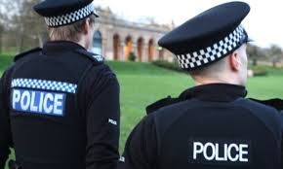
Police Powers
April 22, 2015

Slide 2
POLICE POWER
(political point of view)
- defines the extent to which the police may interfere with the freedom of the individual
(legal point of view)
- various questions of civil and criminal liability depend on the lawfulness or unlawfulness of the use of them

Slide 3
HISTORICAL DEVELOPMENT
until the early 1800s most crime was combated by local constables with the help of the occasional citizen patrol
as cities became more crowded, individual companies organized police forces to protect their interests
the Thames River Police was created by West India Trading Company in 1798

Slide 4
THE THAMES RIVER POLICE
80 full-time men
patrolled the London port
the private police force was so effective that Parliament authorized money to add men to their patrol

Slide 5
ROBERT PEEL
Sir Robert Peel (1788-1850), a Conservative Prime Minister of the United Kingdom from 1834-1835 and again from 1841-1846
created the first professional police force in 1829
Peel sponsored the Metropolitan Police Act which was passed by Parliament

Slide 6
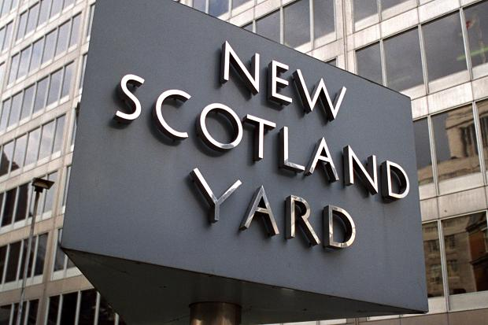
METROPOLITAN POLICE ACT OF 1829
for the first time in Britain’s history, the Act established an organized police force in London, with 17 divisions of 4 inspectors each, its central base at Scotland Yard, under the scope of the Home Secretary

Slide 7
the USA
under Constitutional law, police power is the capacity of the states to regulate behavior and enforce order within their territory for the betterment of the health, safety, morals, and general welfare of their inhabitants
under the 10th Amendment to the United States Constitution, the powers not specifically delegated to the Federal Government are reserved to the states or to the people

Slide 8
CURRENT SITUATION
the powers of the police in England and Wales are defined largely by statute law, with the main sources of power being the Police and Criminal Evidence Act 1984 and the Police Act 1996
the Home Office (the lead government department for immigration and passports, drugs policy, counter-terrorism and police) is responsible for policing in England and Wales
43 police forces in England and Wales employing over 233,000 personnel

Slide 9
The Police and Criminal Evidence Act 1984 (PACE)
instituted a legislative framework for the powers of police officers in England and Wales to combat crime, as well as providing codes of practice for the exercise of those powers
the aim of PACE is to establish a balance between the powers of the police in England and Wales and the rights and freedoms of the public

Slide 10
Some general police powers
- to detain people in connection with an offence
- the limited power to stop and search people/vehicles in connection with offences (actual or suspected)
- the power to arrest people without warrant for minor offences
- the power to direct the behavior of persons and vehicles on highways and in other public places

Slide 11
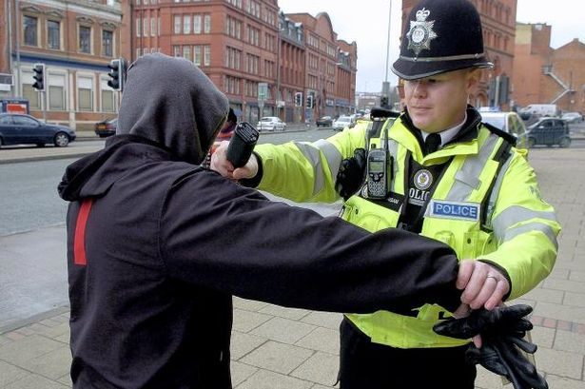
MAIN POLICE POWERS
arrest
search
entry
seizure
detention

Slide 12
ARREST
the police can arrest persons suspected of having committed an offence with or without a warrant issued by a court
for serious offences (“arrestable offences”) a suspect can be arrested without a warrant
general arrest power (to prevent injury or damage)

Slide 13
SEARCH
the official examining of a person or a place
a police officer has the power to stop and search people and vehicles if there are reasonable grounds for suspecting that stolen goods or weapons will be found
the officer must state and record the grounds for taking this action
an unlawful search constitutes assault

Slide 14
ENTRY
the right of the police to enter private property to find the wrongdoer
the police can enter premises to make an arrest and search them to find their suspect
unlawful entry constitutes the tort of trespass

Slide 15
SEIZURE
the instance of taking possession of somebody’s property by the authority
when a lawful arrest is made, the police can seize articles and documents that could be used in evidence against the suspect
the police can take any weapon or article that the suspect could use to harm himself or others

Slide 16
DETENTION
an arrested person must be taken to a police station
the suspect has a right to speak to an independent solicitor free of charge
a suspect may refuse to answer police questions (”the right to silence”) according to the Criminal Justice and Public Order Act of 1994
police custody:
lesser offences: 24 hours
serious offences: up to 96 hours without being charged

Slide 17
The right to silence
first codified in the Judges' Rules in 1912
a defendant in a criminal trial has a choice whether or not to give evidence in the proceedings
there is no general duty to assist the police with their inquiries

Slide 18
PACE 1994, Code C
adverse inferences may be drawn in certain circumstances where the accused:
fails to mention any fact which he later relies upon and which in the circumstances at the time the accused could reasonably be expected to mention
fails to give evidence at trial or answer any question
fails to account on arrest for objects, substances or marks on his person, clothing or footwear, in his possession, or in the place where he is arrested
fails to account on arrest for his presence at a place

Slide 19
Miranda Warning
Miranda rights/Miranda rule
a right to silence warning given by police in the USA to criminal suspects in police custody (or in a custodial interrogation) before they are interrogated to preserve the admissibility of their statements against them in criminal proceedings and to protect their 5th Amendment right against compelled self-incrimination

Slide 20
Miranda v Arizona (1966)
the Supreme Court found that the 5th and 6th Amendment rights of Ernesto Miranda had been violated during his arrest and trial for armed robbery, kidnapping, and rape of a mentally handicapped young woman
the person in custody must, prior to interrogation, be clearly informed that he/she has the rights

Slide 21
as a result, American English developed the verb mirandize, meaning "read the Miranda rights to" a suspect (when the suspect is arrested)
the Miranda rights do not have to be read in any particular order, and they do not have to precisely match the language of the Miranda case as long as they are adequately and fully conveyed

Slide 22
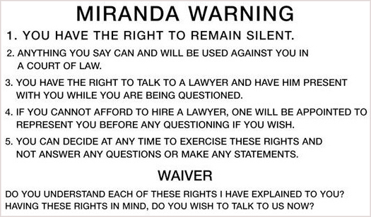

Slide 23
Vocabulary
admissible statements
arrestable offences
criminal liability
compelled self-incrimination
custodial interrogation
lawful arrest
legislative framework
police custody
reasonable grounds
stolen goods
unlawful search

Slide 24
to arrest a suspect
to delegate power
to detain a suspect
to enforce order
to enter premises
to exercise power
to interrogate a suspect
to issue a warrant
to seize evidence
to stop and search

Slide 25
THANK YOU !!!

