Slide 1
The European Convention and its impact on Croatian Administrative law

Slide 2
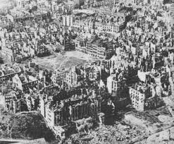
Historical context
After the traumas of the second world war, the UN’s Universal Declaration of Human Rights of 1948 was the first global expression of rights to which all human beings are inherently entitled.

Slide 3
Art. 2 of the Universal Declaration (UN)
„Everyone is entitled to all the rights and freedoms set forth in this declaration, without distinction of any kind, such as race, colour, sex, language, religion, political or other opinion, national or social origin, property, birth or other status. Furthermore, no distinction shall be made on the basis of the political, jurisdictional or international status of the country or territory to which a person belongs, whether it be independent, trust, non-self-governing or under any other limitation of sovereignty.”

Slide 4
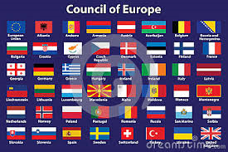
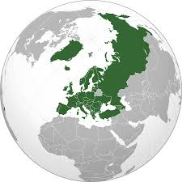
Council of Europe
Founded in 1949.
1946 – W. Churchill – a plea for a „kind of United States of Europe”.
Treaty of London – Statute of the Council of Europe.
Signed by Belgium, Denmark, France, Ireland, Italy, Luxembourg, the Netherlands, Norway, Sweden and the United Kingdom.
Now all european countries (minus Belarus).
Founding fathers: Churchill, Adenauer, Schuman, Spaak, de Gasperi and Bevin.

Slide 5
Winston Churchill
Zurich speech about a United states of Europe.

Slide 6
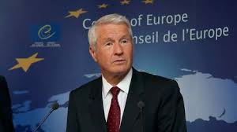
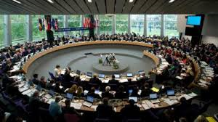
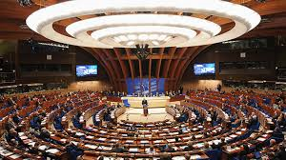
Institutions of the Council of Europe
The Secretary General, who is elected for a term of five years by the Parliamentary Assembly. The current Secretary General is the former Prime Minister of Norway, Thorbjørn Jagland (reelected for five new years on 24 June 2014.).
The Committee of Ministers, comprising the Ministers of Foreign Affairs of all 47 member states who are represented by their Permanent Representatives and Ambassadors accredited to the Council of Europe.
The Parliamentary Assembly (PACE), which comprises national parliamentarians from all member states and elects its President for a year with the possibility of being re-elected for another year. National parliamentary delegations to the Assembly must reflect the political spectrum of their national parliament, i.e., comprise government and opposition parties.

Slide 7
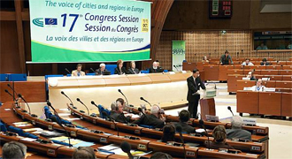
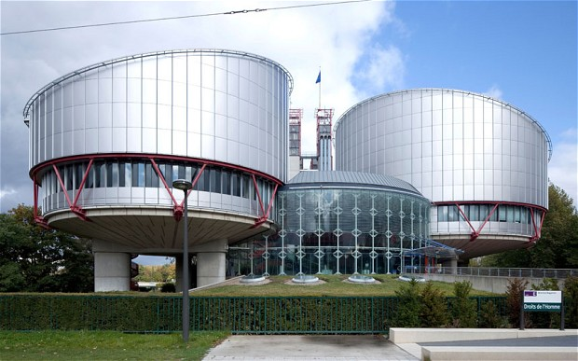
Institutions of the Council of Europe
The Congress of the Council of Europe (Congress of Local and Regional Authorities of Europe), which was created in 1994 and comprises political representatives from local and regional authorities in all member states. The most influential instruments of the Council of Europe in this field are the European Charter of Local Self-Government of 1985 and the European Outline Convention on Transfrontier Co-operation between Territorial Communities or Authorities of 1980.
The European Court of Human Rights, created under the European Convention on Human Rights of 1950, is composed of a judge from each member state elected for a renewable term of six years by the Parliamentary Assembly and is headed by the elected President of the Court. Since 2007, Jean-Paul Costa from France is the President of the Court. Under the new Protocol No. 14 to the European Convention on Human Rights, the terms of office of judges shall be nine years but non-renewable.
The Commissioner for Human Rights, who is elected by the Parliamentary Assembly for a non-renewable term of six years since the creation of this position in 1999. Since April 2012, this position has been held by Nils Muižnieks from Latvia.
The Conference of INGOs. NGOs can participate in the INGOs Conference of the Council of Europe. Since the [Resolution (2003)8] adopted by the Committee of Ministers on 19 November 2003, they are given a "participatory status".
Information Offices of the Council of Europe in many member states.

Slide 8
Council of Europe as an international organisation
It is an organisation of states founded on the basis of an international treaty.
It has its statute and common organs.
It has its one budget.
It is a subject of international law.
It also has elements of an supranational organisation (because of the jurisdiction of the ECHR).

Slide 9
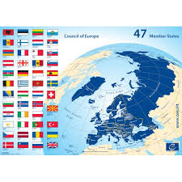
Croatia as a member of Council of Europe
Membership application: 4th of May 1992.
Postponed 1993-1995.
On 15th of March 1996 Croatia agreed to fulfill 21 political obligation.
Membership approved.
Croatia signed the Convention on 6th of November 1996 and became a member of the Council of Europe.
September 2003 – monitoring concluded.

Slide 10
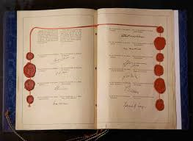
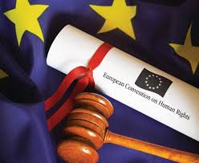
The Convention
There are 17 key articles relating to rights and freedoms in the convention outlined in section 1 Article 2-18, which include: 2) the right to life; 3) prohibition of torture; 4) the prohibition of slavery and forced labour; 5) the right to liberty and security; 6) the right to a fair trial; 7) no punishment without law; 8) the right to respect for private and family life; 9) freedom of thought, conscience and religion and 10) freedom of expression.

Slide 11
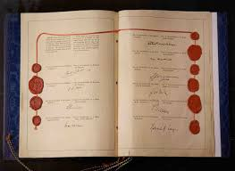
The Convention
11) freedom of assembly and association, 12) right to marry, 13) right to an effective remedy, 14) prohibition of discrimination.
Catalogue of rights.

Slide 12
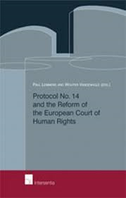
The Protocols
Protocol 1 – protection of property, right to education, right to free elections.
Protocol 4 – prohibition of imprisonment for debt, freedom of movement, prohibition of expulsion of nationals (and collective expulsion of aliens).
Protocol 6 – abolition of death penalty (wit the exception of time of war).
Protocol 7 – safeguards regarding the expulsion of aliens, right of appeal in criminal matters, compensation for wrongful conviction, ne bis in idem, equality between spouses.
Protocol 12 – general prohibition of discrimination.
Protocol 13 – absolute abolition of death penalty.
Protocol 14 - reform of the Court for human rights.

Slide 13
Supervisory system regarding the application of the Convention
Until 1998 there were two bodies:
European commission for human rights
Court for human rights (not in permanent session).
Since 1998 and Protocol 11, permanent European Court for human rights (ECHR).

Slide 14
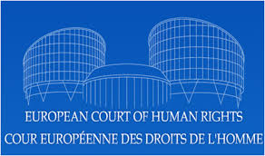
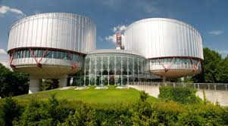
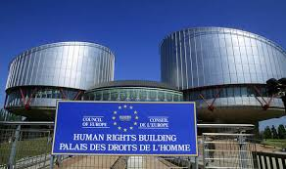
The Court
It is the international court based in Strasbourg, which was set up in 1959 and implements the convention. This is the place where rules on individual or state applications, alleging violations of civil and political rights set out in the convention, are made. It is also the physical place where rulings are made.

Slide 15
The Court
The court is responsible for monitoring respect for the human rights of 800 million Europeans within the 47 Council of Europe member states that have ratified the convention.
At present, 47 judges – who are elected for a non-renewable term every nine years by the parliamentary assembly of the Council of Europe – sit at the court. They are totally independent and can not engage in any activity that would hinder their impartiality. Since the court was established, most cases have been lodged by individuals.

Slide 16
Determining the jurisdiction of the ECHR
Jurisdiction ratione personae (the complaint is not admissible if it is submitted against a non party of the Convention, against a private natural or legal person)
Jurisdiction ratione materiae (the complaint must be based on a infringement of the convention)
Jurisdiction ratione temporis (only for events that have transpired after the ratification of the Convention).
Jurisdiction ratione loci (only for acts that have transpired on the territory of a member state).
Principle of subsidiarity.

Slide 17
The Impact
Article 6
1. In the determination of his civil rights and obligations or of any criminal charge against him, everyone is entitled to a fair and public hearing within a reasonable time by an independent and impartial tribunal established by law. Judgment shall be pronounced publicly but the press and public may be excluded from all or part of the trial in the interests of morals, public order or national security in a democratic society, where the interests of juveniles or the protection of the private life of the parties so require, or to the extent strictly necessary in the opinion of the court in special circumstances where publicity would prejudice the interests of justice.
2. Everyone charged with a criminal offence shall be presumed innocent until proved guilty according to law.
3. Everyone charged with a criminal offence has the following minimum rights: (a) to be informed promptly, in a language which he understands and in detail, of the nature and cause of the accusation against him; (b) to have adequate time and facilities for the preparation of his defence; (c) to defend himself in person or through legal assistance of his own choosing or, if he has not sufficient means to pay for legal assistance, to be given it free when the interests of justice so require; (d) to examine or have examined witnesses against him and to obtain the attendance and examination of witnesses on his behalf under the same conditions as witnesses against him; (e) to have the free assistance of an interpreter if he cannot understand or speak the language used in court.

Slide 18
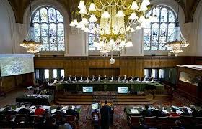
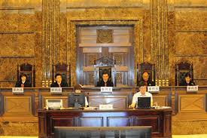
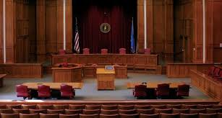
Public hearing
Croatia entered a reserve regarding the obligation to hold a public hearing.
Nevertheless, that created a situation because of the link between administrative procedure and administrative dispute, in which the legal regulation was not aligned with the Convention.

Slide 19
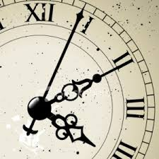
Reasonable time
Because of the ECHR, reasonable time in processes is established.
Time limit starts to count from the point where an appeal is made in administrative procedure.
Time limit: 3 years.

Slide 20
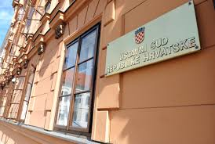
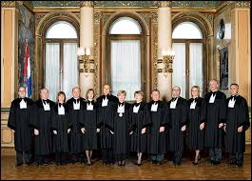
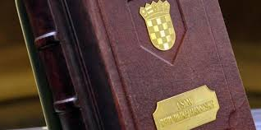
Independent and impartial tribunal
The Constitution court:
In order for a court to be an independent and impartial tribunal according to the Convention it has to:
1) be able to deduct evidence and to determine facts
2) hold public and contradictory hearings

Slide 21
Result?
Reform of the administrative procedure and administrative dispute.
Alignment with the Convention.
Legal certainty.

