Slide 1
Types of State Organization

Slide 2
Types
Unitary
Confederal
Federal

Slide 3
Unitary state
A unitary state is a state governed as one single unit in which the central government is the decision centre. Subnational and local governments exercise only the power that the central governments choose to delegate.
The UK and Croatia

Slide 4
A devolved state
A devolved state is a centralized state such as the United Kingdom, where subnational governments have a degree of autonomous power devolved from the central government. A devolved government cannot challenge the constitutionality of central government's law. The power given by the central government can be revoked, or reduced. For example, the Northern Ireland Assembly has been suspended many times by London since its creation. In theory, decentralized and devolved states are different, but in practice the differences are very thin.

Slide 5
A decentralized state
A decentralized state is generally a former unitary state. The authority and responsibility for some public functions have been transferred from the central government to the regional government.

Slide 6
Confederal state
Confederations are voluntary associations of independent states that, to secure some common purpose, agree to certain limitations on their freedom of action and establish some joint machinery of consultation or deliberation.
A confederation (also known as a confederacy or league) is a union of sovereign states, united for purposes of common action often in relation to other states.
Germany

Slide 7
A federal state
A federal state is a type of sovereign state in which sovereignty is constitutionally divided between a central government and the subnational governments.
USA

Slide 8
American federalism
The United States of America is a federal republic composed of 50 states
The former British colonies (13) broke with Great Britain in 1776 and were recognized as a new nation following the Treaty of Paris in 1783
During the 19th and 20th centuries 37 new states were added to the original 13

Slide 9
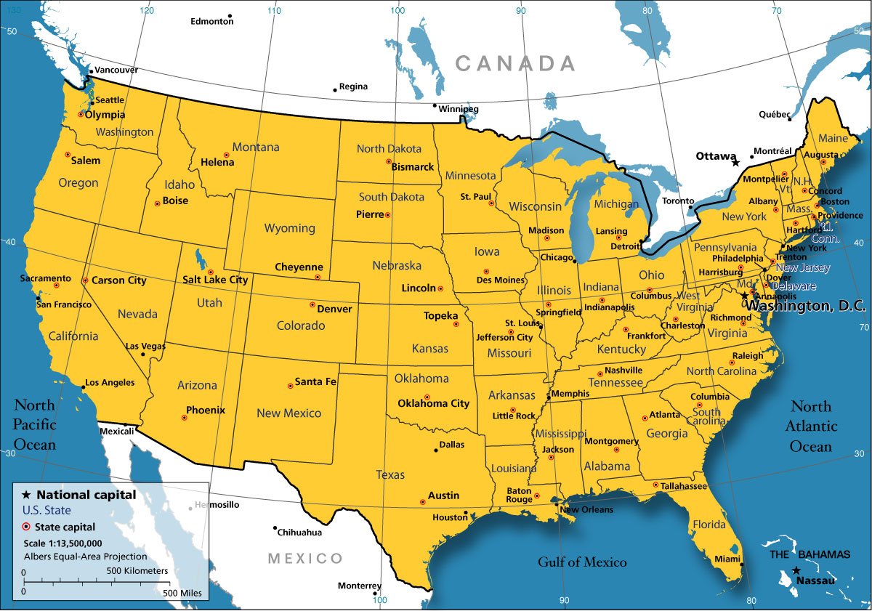

Slide 10
The Declaration of Independence
In 1776 there were 13 weak British colonies in America (Virginia, Delaware, Pennsylvania, New Jersey, New York, Georgia, Connecticut, Massachusetts, Maryland, South Carolina, North Carolina New Hampshire, Rhode Island)
The Declaration of Independence, 1776
“We hold these truths to be self-evident, that all men are created equal, that they are endowed by their Creator with certain unalienable rights, that among these are Life, Liberty and the pursuit of Happiness.”
Mainly written by Thomas Jefferson
American colonists acted to win rights they felt had been denied them as English subjects

Slide 11
The US Constitution
The oldest Constitution still in force (written in 1787, came into force in 1789)
To date there have been 27 amendments
Sets the basic form of government: three separate branches, each one having powers (“checks and balances”) over the others
Specifies the powers and duties of each federal branch of government
Guarantees basic rights for the citizens
The ultimate power is given to the people

Slide 12
Preamble
“We the people of the United States, in order to form a more perfect Union, establish justice, insure domestic tranquility, provide for the common defense, promote the general welfare, and secure the blessings of liberty to ourselves and our posterity, do ordain and establish this Constitution for the United States of America.”

Slide 13
The Bill of Rights
The first ten Constitutional Amendments
Fundamental rights of any American
The freedom of religion, speech, press, the rights of peaceful assembly, the right of trial by jury
These rights cannot be taken away by any government or court
https://www.youtube.com/watch?v=IQNiBQehwp8

Slide 14
Federalism
A form of political organization in which the exercise of power is divided between two levels of government: the nation and the states
Exclusively national powers: determining foreign policy (declaring wars, making treaties, controlling imports and exports); protecting a uniform monetary system - control of the power to coin money

Slide 15
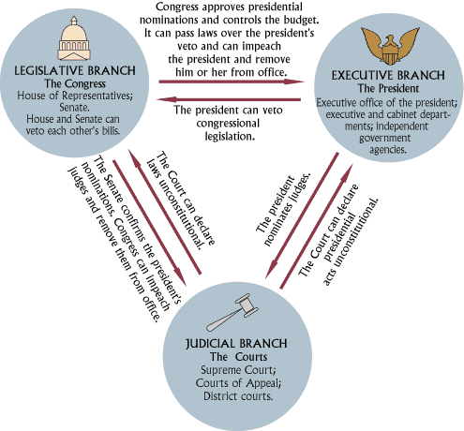
Checks and balances
The Constitution’s Framers set out a government in which no person or branch of government could become all-powerful
They divided the powers among lawmakers, judges and a chief executive
Each group can balance and check other’s powers

Slide 16
Complexity of the modern state
Since the 20th century, the continuing and intensified expansion of state rule has resulted in the tendency of the administrative apparatus to grow in size and complexity.
Economic globalization - a process whereby state functions are transferred to markets.
The EU

Slide 17
Fill in the missing forms where applicable:
NOUN (concept) | NOUN (person) | VERB | ADJECTIVE
administration
 |  | apply
bureaucracy
 |  | delegate
 |  | direct
 |  | execute
 |  | govern
 |  | legislate
 |  | perform

Slide 18
Explain the main functions of the state and include the relevant institutions:
FUNCTION | EXPLANATION | INSTITUTION
legislative
executive
judicial

Slide 19
Match the terms from the text with their definitions:
TERM | DEFINITION
1. Cabinet | a. The system by which a state or community is governed
2. court | b. A body convened to hear a dispute
3. delegated legislation | c. The maximal achievement of goals
3. effectiveness | d. The optimal relation between means and ends
4. efficiency | e. Subordinate legislation, mostly governmental
5. government | f. A body of ministers consisting mostly of heads of chief government departments, headed by the Prime Minister
6. tribunal | g. A body established by law for the administration of justice

Slide 20
Fill in the missing elements in the following collocations from the text:
1. ___________________disputes.
2. __________________the legislative function.
3. __________________laws.
4. __________________operation.
5. __________________the power.
6. __________________the required standards.

Slide 21
Translate into Croatian:
Today, however, we have to say that a state is a human community that (successfully) claims the monopoly of the legitimate use of physical force within a given territory. Note that 'territory' is one of the characteristics of the state. Specifically, at the present time, the right to use physical force is ascribed to other institutions or to individuals only to the extent to which the state permits it. The state is considered the sole source of the 'right' to use violence. Hence, 'politics' for us means striving to share power or striving to influence the distribution of power, either among states or among groups within a state.

Slide 22
Thank you for your attention!

